Slide 1
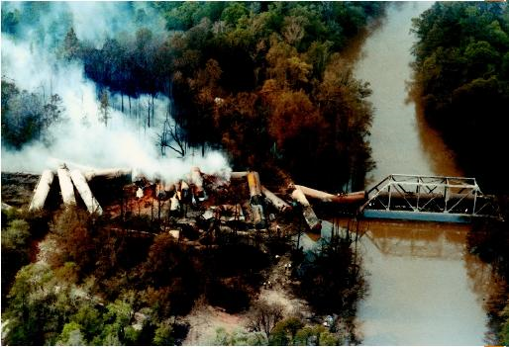
Hospital chemical disaster management
Robert G. Hendrickson, MD
Oregon Poison Center
Oregon Health and Science University
Portland, Oregon, USA

Slide 2
Objectives
Discuss real chemical disasters and their effects on hospitals
  Describe the characteristics of chemical disasters
Describe the necessary steps in hospital response:
  Incident command structure
  Hospital’s role
  Toxicology / Poison Center role

Slide 3
Chemical disasters
Tokyo Sarin Incident
Albertson, Montana - chlorine spill
Texas, October 1987 - HF release
Bhopal, India – methylisocyanate

Slide 4
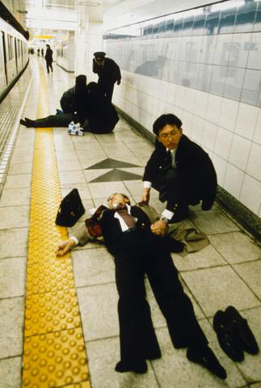
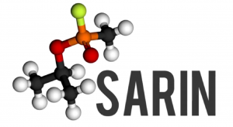
Tokyo 1995

Slide 5
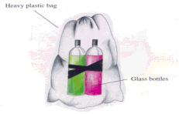
Tokyo, 1995
March 20, 1995, Tokyo, Japan
Aum Shinrikyo
7:55am - Plastic bags containing sarin placed below the seats of a subway car
Bags are punctured with the sharpened end of an umbrella

Slide 6
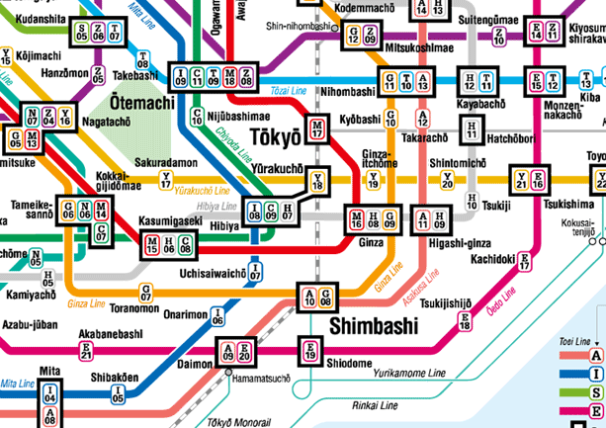
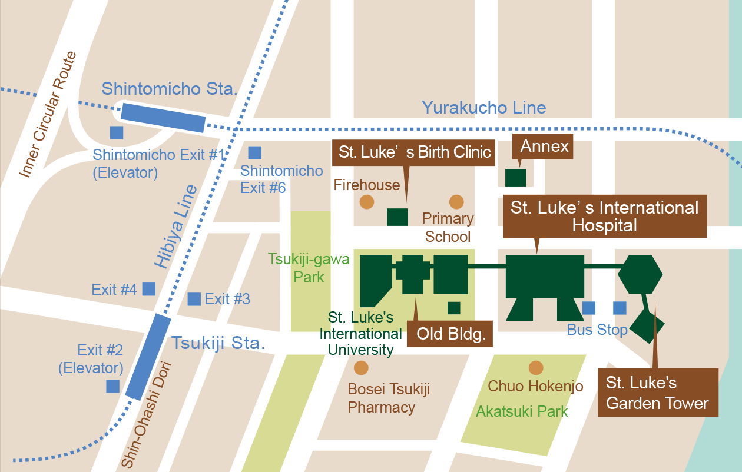
St. Luke’s Hospital, Tokyo
St. Luke’s Hospital is close to 6 subway stations and is the closest hospital to the event.
Notes:
Kasumigaseki = cabinet ministers
Nagatacho = elected government and legislative branch
5 subway cars on 3 lines
St Luke’s hospital is a 520 bed private hospital that is situated <3km from the attack

Slide 7
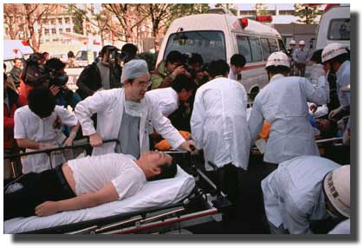
St. Luke’s Hospital, Tokyo
7:55am – sarin released
8:28am(33min)–1st ambulatory patient in ED
8:43am(48min)–1st ambulance arrives
Next hour –
  500 patients arrive in ED
  3 in cardiac arrest
  5 are pregnant

Slide 8


Slide 9
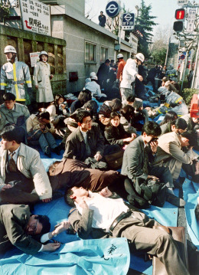
Tokyo
At the scene:

Slide 10
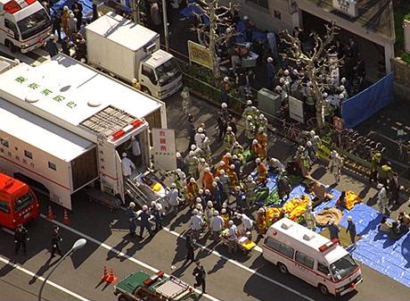
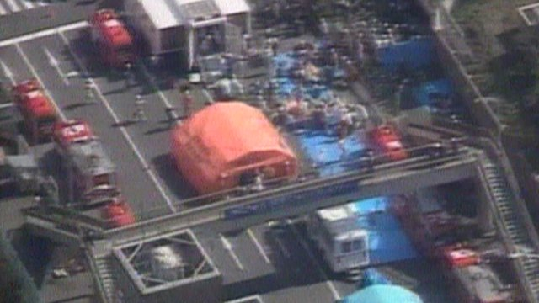
Tokyo
At the scene:

Slide 11
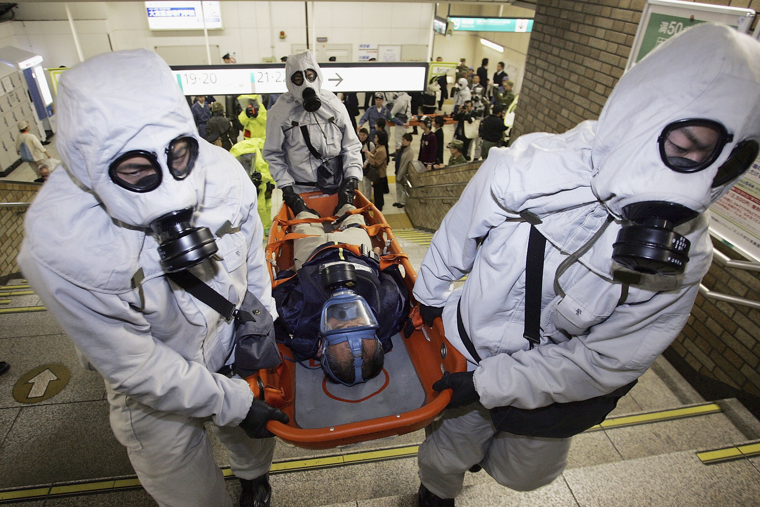

Slide 12
St. Luke’s ER
The first day…
  640 patients in the ED
    64 by ambulance / 35 by police
    541 by non-EMS transport
  Few had pre-hospital decontamination
  5 intubated
  107 “moderate” (SOB, sz, fasciculation)
  2 dead
Okumura T, et al. Ann Emerg Med 1996; 28(2): 129-135

Slide 13
St. Luke’s
729 additional patients over the next 4 days:
  3/21 116 pts
  3/22 319 pts
  3/23 204 pts
  3/24 90 pts
Okumura T, et al. Ann Emerg Med 1996; 28(2): 129-135

Slide 14
Tokyo
St. Luke’s Hospital
  Followed up 500 patients as outpatients over the next few weeks
Okumura T, et al. Ann Emerg Med 1996; 28(2): 129-135

Slide 15
St. Luke’s
23% of staff reported symptoms
  Nurses 26%
  Doctors 22%
  Volunteers 26%
  Nurse assistants 39%
  Clerks 18%
Okumura T, et al. Acad Emerg Med 1998; 5: 618-624

Slide 16
Tokyo
All hospitals:
  11 dead
  5000 patients sought emergency care
Okumura T, et al. Acad Emerg Med 1998; 5: 618-624

Slide 17
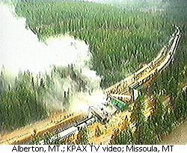
Alberton, MT

Slide 18
Alberton, MT
April 11, 1996, ~4am
4 tanker cars containing chlorine derailed on its way to a paper mill
122,000 pounds of chlorine spilled

Slide 19
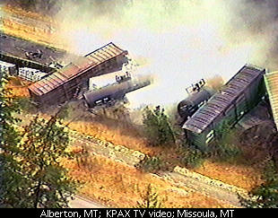
Alberton, MT
1000 people evacuated from Alberton and Frenchtown, MT
Over 500 patients in the hospital ED
352 hospitalized
1 dead
I-90 shut down for 19 days for cleanup

Slide 20
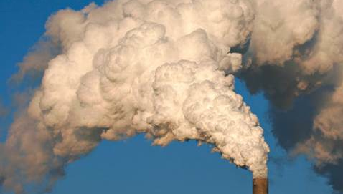
Texas, US, 1987

Slide 21
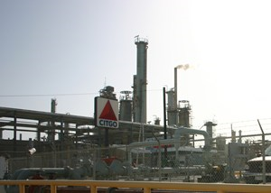
Texas - 1987
A petro-chemical plant accidentally released 53,000 pounds of hydrofluoric acid
HF formed vapor over a community of 41,000 people
Notes:
2 pipes containing isobutane-saturated HF were shearing during maintenance.
Cloud fell over town – 41K residents, homecoming night
Response swift:
Water curtain erected within 7 minutes
20min – all people within 0.8K were evacuated
Shortly after, 3000 people evacuated from a 8 km2 area

Slide 22
Texas - 1987
939 victims arrive at the hospital
  94 admitted to the hospital
  845 discharged
Downwind – over a 3.2km area
  Vegetation loss
  Car windows etched
Wing JS, et al. Arch Environ Health 1991; 46(3): 155-160

Slide 23
Texas - 1987
Symptoms
  Irritant
    62% eye/throat burning
    19% shortness of breath
    16% cough
  Nonspecific
    Headache 21%
    Vomiting 7%
  120 (14%) had no complaints
Wing JS, et al. Arch Environ Health 1991; 46(3): 155-160

Slide 24

Notes:
CO + chlorine yields phosgene, phosgene combined with monomethylamine to form MIC. MIC is mixed with naphthol to produce carbaryl.

Slide 25
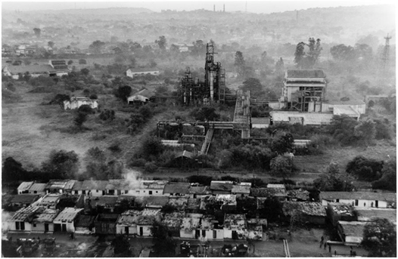
Bhopal, India

Slide 26
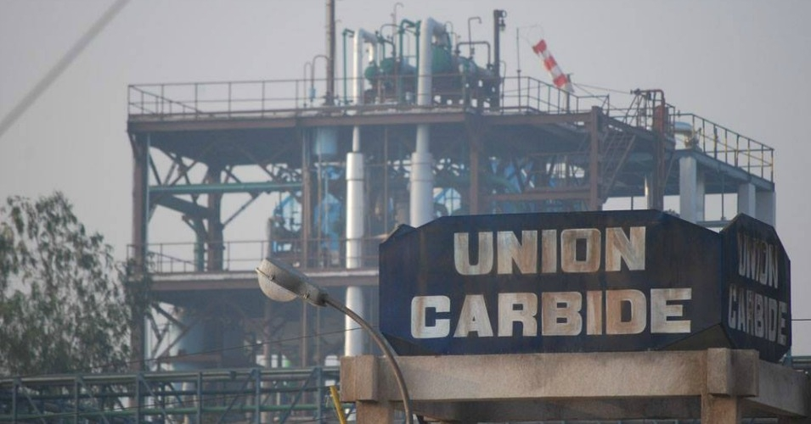
Bhopal, India
Union Carbide plant in Bhopal, India, 1984

Slide 27
Bhopal, India
Union Carbide plant in Bhopal, India, 1984
  Produced carbaryl (Sevin®), a carbamate pesticide
    CO + Cl₂ -> COCl₂ (phosgene)
    COCl₂ + CH₃NH₂ -> CH₃NHCOCl + HCl -> HCl + CH₃NCO (MIC)
    CH₃NCO (MIC) + naphthol -> carbaryl
Notes:
CO + chlorine yields phosgene, phosgene combined with monomethylamine to form MIC. MIC is mixed with naphthol to produce carbaryl.

Slide 28
Bhopal, India
Introduction of water into MIC storage tank -> uncontrollable hyperthermic reaction
  Safety systems fail:
    Flare tower (for burning off excess gas)
      Disconnected for maintenance
    Caustic soda scrubber (neutralization)
      Turned off
    Refrigeration unit –
      shut down to save money
Notes:
CO + chlorine yields phosgene, phosgene combined with monomethylamine to form MIC. MIC is mixed with naphthol to produce carbaryl.

Slide 29
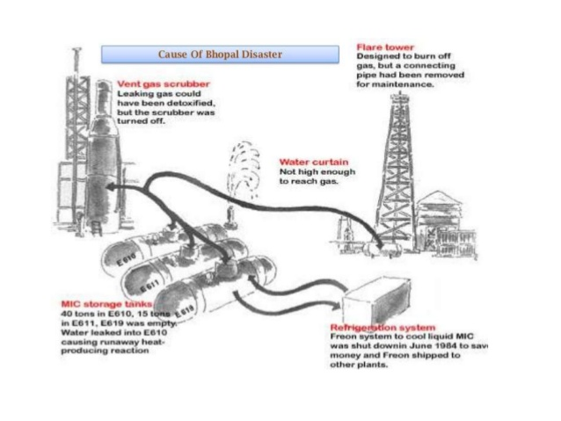
Bhopal Union Carbide Disaster

Slide 30
Bhopal, India
Introduction of water into MIC storage tank -> uncontrollable hyperthermic reaction that releases:
  27 tons of methylisocyanate

Slide 31
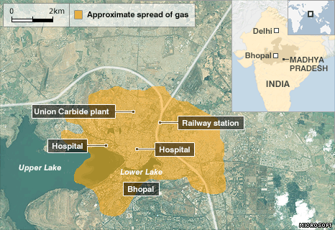

Slide 32
Bhopal, India
Methylisocyanate (MIC)
  Moderately soluble irritant gas
  May decompose to hydrogen cyanide, nitrogen dioxide, and carbon monoxide
Phosgene, CO, HCL are used in production and were also likely released

Slide 33
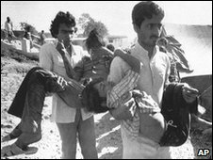
Bhopal, India
Weather:
  Thermal inversion
Initial mild mucosal irritation
  Panic
  Many left their homes
Dipersion modeling predicts ground-level concentrations from 0.12 ppm to 85.6ppm
  NIOSH IDLH = 3ppm
Notes:
124/158 surveyed ran from homes

Slide 34
Bhopal, India
200,000 exposed
  6000-12,000 deaths
  Early deaths = 300 autopsies = necrotizing lesions of respiratory tract
  Later deaths mostly from respiratory failure and respiratory infections

Slide 35
Bhopal, India
3 month follow up:
  18% had abn CXR
  39% abn spirometry
  33% respiratory symptoms
    Symptoms correlated inversely with distance to plant
  Biopsies: interstitial fibrosis and bronchiolitis obliterans, similar to animal studies

Slide 36
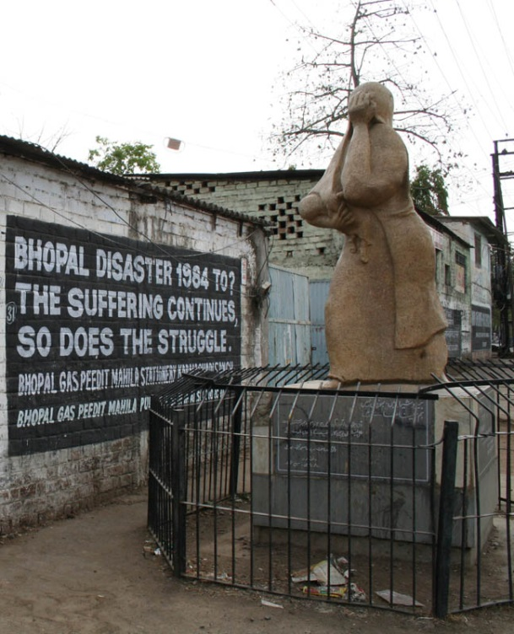
Bhopal, India
10 year follow up:
  Respiratory symptoms correlate with predicted dose of MIC
  FEV _{25-75%} (small airway obstruction) declined linearly with distance to plant

Slide 37
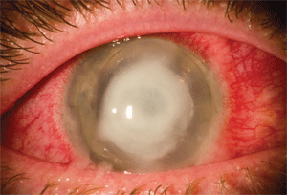
Bhopal, India
Bhopal eye syndrome – 1000s
  Initial keratopathy, chemosis, corneal ulceration
  Chronic eye watering, photophobia, irritation

Slide 38
Bhopal, India

Slide 39
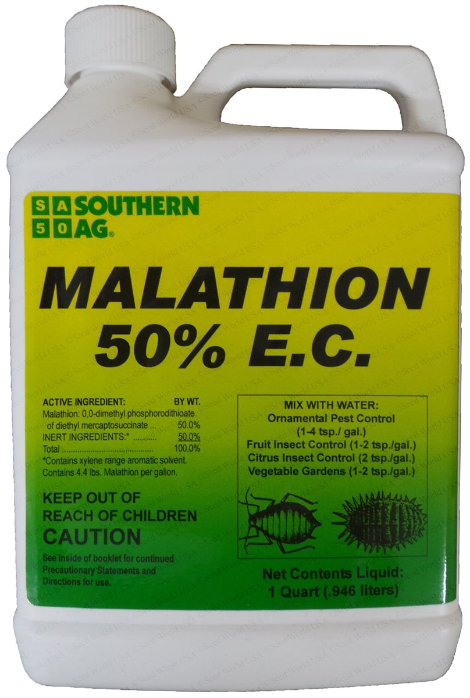
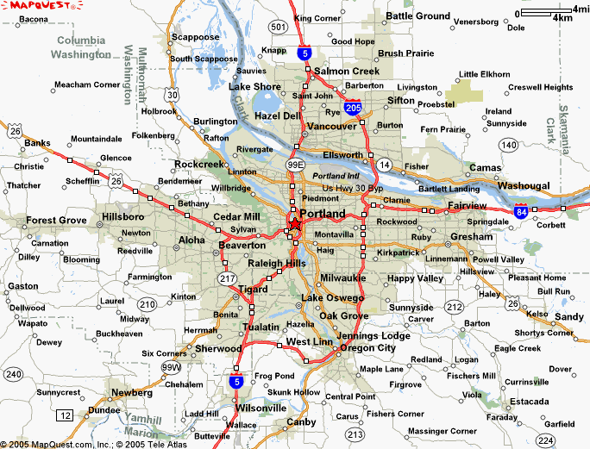
Portland, OR, USA

Slide 40
Portland, OR, USA
September, 2003
  Intentional suicidal ingestion of malathion
  Transported by ambulance
  Patient arrives
    Unconscious
    Diaphoretic, vomiting, salivating
  Brought into ED

Slide 41
Portland, OR, USA
Treatment
  Intubation
  Atropine (24 mg over 24 hrs)
  2-pam
  Diazepam
  Clothing removed and left on floor

Slide 42
Portland, OR, USA
ED overwhelmed by odor
  Other patients develop respiratory and eye symptoms
  Paramedics develop symptoms
  ED doors opened and fans brought in to ventilate
  Ambulance out of service
  ED closed for > 6 hours

