Slide 1
Day 1
Hazard Identification & Control

Slide 2
Objectives
By the end of this session, you will:
  Identify and recognize the exposures and hazards linked to work-related illnesses and injuries.
  Develop solutions and strategies to address these identified hazards.

Slide 3
Workplace injuries & illnesses in Thailand
What do you think are the top causes?

Slide 4
Notes:
Table 2 shows Top 10 causes of occupational accidents during 2003 – 2011. The first cause of occupational accident is cut or stabbed by materials or objects, the second cause is materials/objects collapsed/felt on top, and the third cause is materials or objects or chemical substances splashed into eyes. In 2011, the first cause of occupational accident, cut or stabbed by materials or objects, was 10 times higher than that of the tenth occupational accident, results of extreme heat/exposed to heat.

Slide 5
Image credit: Oregon OSHA (http://orosha.org/educate/materials/Hazard-Identification-120/9-120print.pdf)
Notes:
It takes a hazard and someone exposed to the hazard to produce an incident.
Risk: The measure of the probability and severity of an adverse effect caused by a hazard

Slide 6
Top hazards for priority industries
Chemical (examples)
Ergonomic (examples)
Other health (noise, stress, radiation)
Safety (examples)
Notes:
Use flip chart or white board. Ask volunteers to come up or verbally share some examples. As they identify something, include type or industry or workplace as relevevant.

Slide 7
Hazard Types: This week’s priorities
CHEMICAL & DUST HAZARDS
(cleaning products, pesticides, asbestos, etc.)
ERGONOMIC HAZARDS
(repetition, lifting, awkward postures, etc.)
BIOLOGICAL HAZARDS
(mold, insects/pests, communicable diseases, etc.)
1
2
SAFETY HAZARDS
(slips, trips and falls, faulty equipment, etc.)
WORK ORGANIZATION HAZARDS
Things that cause STRESS!
PHYSICAL HAZARDS
(noise, temperature extremes, radiation, etc.)
4
3

Slide 8
Image credit: Oregon OSHA (http://orosha.org/educate/materials/Hazard-Identification-120/9-120print.pdf)

Slide 9
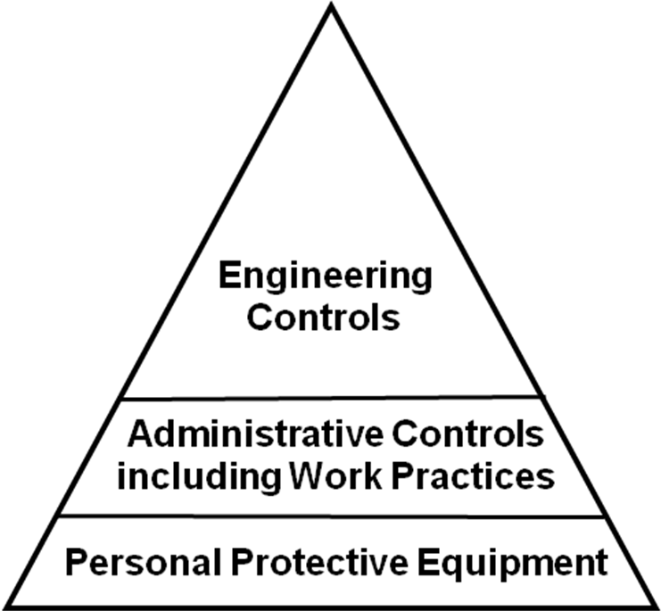
Hierarchy of Controls
Elimination/Substitution
Most Effective
Requires a physical change to the workplace
Requires worker or employer to do something
Requires worker to wear something
Least Effective
Notes:
These are referred to as the hierarchy of controls, how you prevent or control a hazard:
Instructor use examples from white board to give examples of controls. Insert pictures?
Elimination/Substitution: The main goal for any fix to a hazard or exposure is to eliminate it altogether or substitute a product or method of doing the work to a less hazardous alternative. (e.g. green cleaning products)

Slide 10
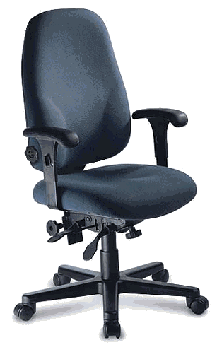
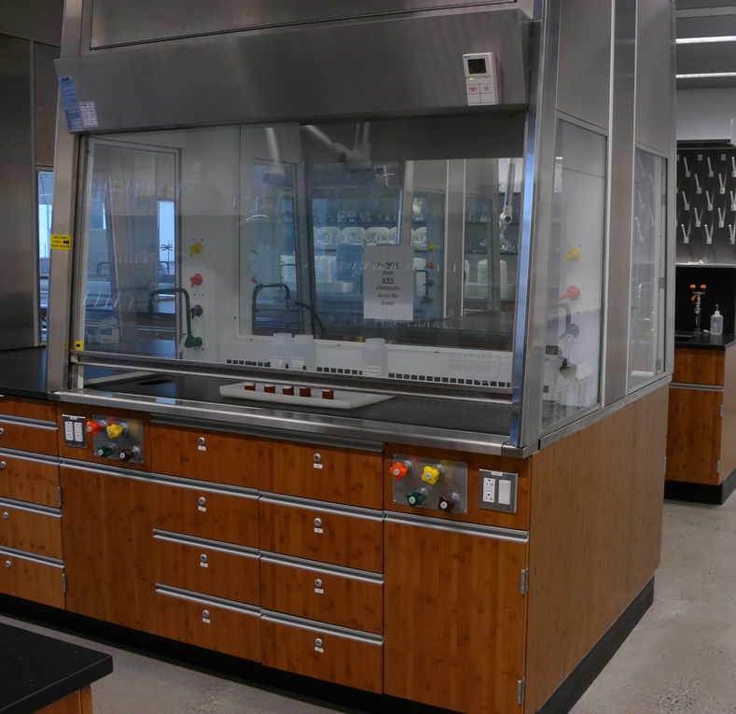
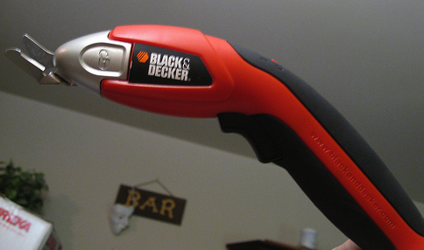
CONTROLS: Engineering
CONTROL AT THE SOURCE!
Limits the hazard but doesn’t entirely remove it.
Other Examples:
Mechanical Guards
Wet Methods for Dust
Enclosures/Isolation
Dilution Ventilation
Image: by JohnRH4's photostream
Image: by Kare_Products
Local Exhaust
Proper equipment
Image: by purpleslog’s photostream
Re-designed Tools
Notes:
The basic concept behind engineering controls is that, to the extent feasible, the work environment and the job itself should be designed to eliminate hazards or reduce exposure to hazards. While this approach is called engineering controls, it does not necessarily mean that an engineer is required to design the control. Engineering controls are the "first line of defense" against injury/illness, because they have the potential to completely eliminate a hazard, and do not rely on human behavior to be effective. For instance, rather than require employees to wear respiratory protection which must be monitored, inspected, trained, managed, it's much more effective to install a ventilation system that does not require any of those management activities or, better yet, find an alternative substitute that is less hazardous.
Images from: Creative Commons:
You are free:
to Share — to copy, distribute and transmit the work
to Remix — to adapt the work
Under the following conditions:
Attribution — You must attribute the work in the manner specified by the author or licensor (but not in any way that suggests that they endorse you or your use of the work).
Image: by Kare_Products
Image: by JohnRH4's photostream
Image: by purpleslog's photostream

Slide 11
CONTROLS: Administrative
Aimed at Reducing Employee Exposure to Hazards but Not Removing Them!
Changes in work procedures such as:
  Written safety policies/rules
  Schedule changes, such as:
    Lengthened or Additional Rest Breaks
    Job Rotation
    Adjusting the Work Pace
Training with the goal of reducing the duration, frequency and severity of exposure to hazards
Notes:
Administrative controls (or work practice controls) are changes in work procedures such as written safety policies, rules, supervision, schedules, and training with the goal of reducing the duration, frequency, and severity of exposure to hazardous chemicals or situations.
As with work practice controls, administrative controls normally are used in conjunction with other controls that more directly prevent or control exposure to hazard.
Image: Powerpoint Clipart

Slide 12



CONTROLS: PPE
Personal Protective Equipment
Control of LAST RESORT!
Special Clothing
Eye Protection
Hearing Protection
Respiratory Protection
CONTROL IS AT THE WORKER!
Notes:
Personal protective equipment (PPE): A method that prevents a worker from being exposed to the hazard by something the worker wears (e.g., gloves, hardhat, of safety glasses). PPE is considered the method of last resort because PPE does nothing to reduce or eliminate the hazard. If the PPE fails, immediate exposure is the result. Examples of PPE include:
a. Special clothing: like gloves, aprons, boots, coveralls, etc.
b. Eye protection: like safety glasses or face shields
c. Hearing protection
Respiratory protection: for emergency or short-term protection.
Images: all from OSHA website

Slide 13
Hierarchy of Controls
Elimination/Substitution
Most Effective
Requires a physical change to the workplace
Requires worker or employer to do something
Requires worker to wear something
Least Effective

Slide 14
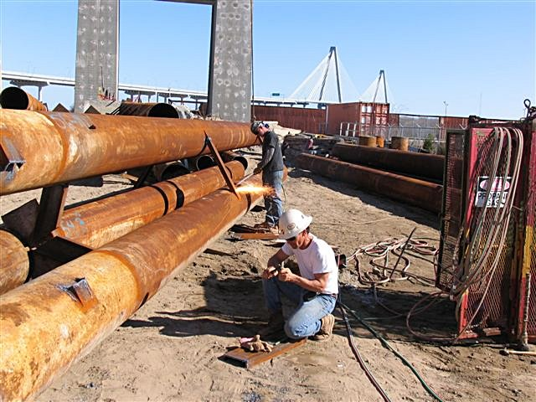
Medical Directorship
Employer On-Site Clinics

Slide 15

What is important to know about the company?
Tour the facility
Talk with management, safety, medical staff
Talk with the return to work coordinator
Gather information about the company and the workers
Complete a company worksite assessment
Create an audit form specific to the company
Recommendations, agreements and action plan form
Communicate to management and medical staff

Slide 16
Medical Protocols for the Employer Nurse
Must be written and evidence based, reviewed and signed annually
Must be appropriate for the scope of practice of employee
Most protocols will be general primary care
Must include special protocols specific to the hazard and needs
Conduct quality checks on equipment
Instructions on situations to contact the Medical Director
Agreement on audit schedule
Medical Director and OH Nurse available for consult/support

Slide 17
What does the nurse do?
Tour
Gather information
Complete the Worksite Assessment
Advise
Collaborate and get agreement on a plan
Create the audit form
Conduct the audit
Document
Communicate to management and medical staff

Slide 18
What does the physician do?
Tour
Complete the Walkthrough Assessment
Sign protocols
Identify special hazards and protocols
Audit documentation
Be a resource to the company nurse

Slide 19
Main ways to identify hazards
Walk through surveys
Inspection checklists
Past records
Accident investigations
Consultation
Documentation

Slide 20
What do I need to know and ask?
What is a hazard?
What should I look for?
How do I perform the inspection?
How do I document the inspection?
How do I evaluate the hazards?
What type of control measure(s) should I use?
What standards do I reference?

Slide 21
Job Hazard Analysis (JHA)
Notes:
Because the f
irst thing
you do is list every step in the operation, you now have a step by step tool to tell
someone how you want them to do a job. Next you have all the hazards listed out
that match up with the steps. This allows you to tell them what to be car
eful
around. Third is the list of protective measures that the employee is
required to use.
I would say that if your training gave employees that much information
they are
well on their way to working safely. T

Slide 22

How to conduct an inspection?

Slide 23
Tips: Look for poor work practices
  Using machinery or tools without authority, training or controls.
  Operating at unsafe speeds.
  Removing or bypassing guards.
  Using defective tools or equipment, or using unsafely.
  Using body instead of tools or ergonomic aids.
  Overloading, crowding or failing to balance materials .
  Repairing or maintaining equipment that is in motion, under pressure, or electrically charged.
  Falling to use, maintain or use properly PPE or other safety devices.
  Creating unsafe, unsanitary or unhealthy conditions
  Standing or working under suspended loads, scaffolds, shafts or open hatches.
Notes:
Identify potential hazards so they are corrected before an injury occurs
Equipment can be off-line
Safety devices can be disabled or fail to operate
Several tasks may be concurrent
Procedures are not always followed
People are not always available
How we act is not always how we plan to act
Things can take twice as long as planned
Abnormal conditions
- Power failure
Staff shortages or temporary hires

Slide 24
What to Look for
High Hazard Areas: Equipment and operations
that involve energy transfer including: chemical, mechanical, pneumatic, physical, electrical, gravitational, etc. (unsafe conditions)
Procedures and behaviors, including: Use of protective equipment, safe operating speeds, following proper procedures, horseplay, inattentive behavior, etc. (unsafe acts)

Slide 25
Tools
Hazard mapping
Job hazard analysis
Inspection checklists
Reviewing injury and illness reports
Safety committee reports
Interviews

Slide 26
Inspection checklist (many examples)
Ergonomics: computer workstations
Environmental controls
Infection controls
General manufacturing

Slide 28
Sample Inspection Report
Source: WorkSafe BC (www2.worksafebc.com/pdfs/CertificationandTraining/JHSC/JHSC_Inspections_Workbook.pdf)

Slide 29
Hazard Inspection Guidelines
Decide what to inspect
Prepare an inspection sequence
Use a checklist
Ask employees in area for input
Record observations – location and nature of hazards
Document the inspection participants

Slide 30

Practicum 1: Identify hazards

Slide 31
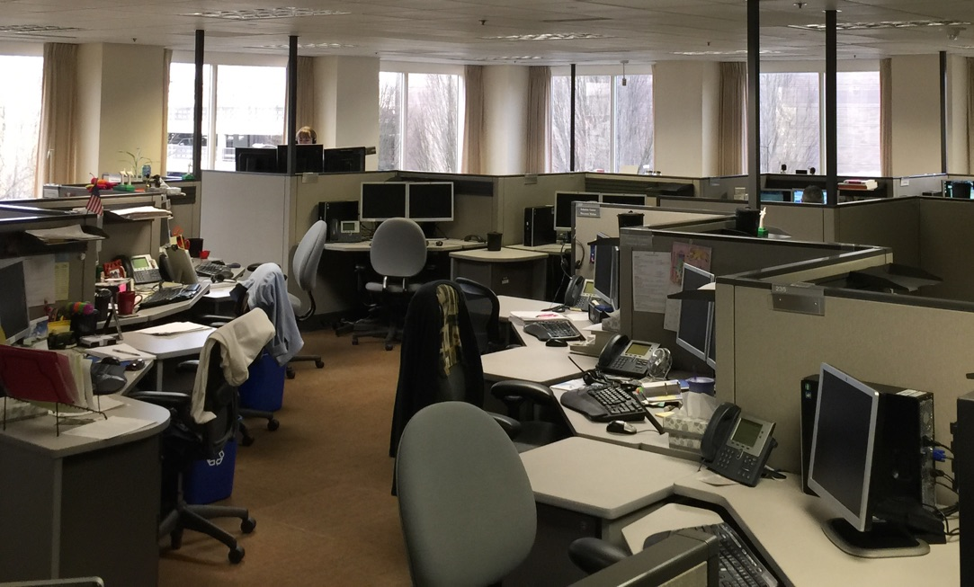
Let’s Practice

Slide 32
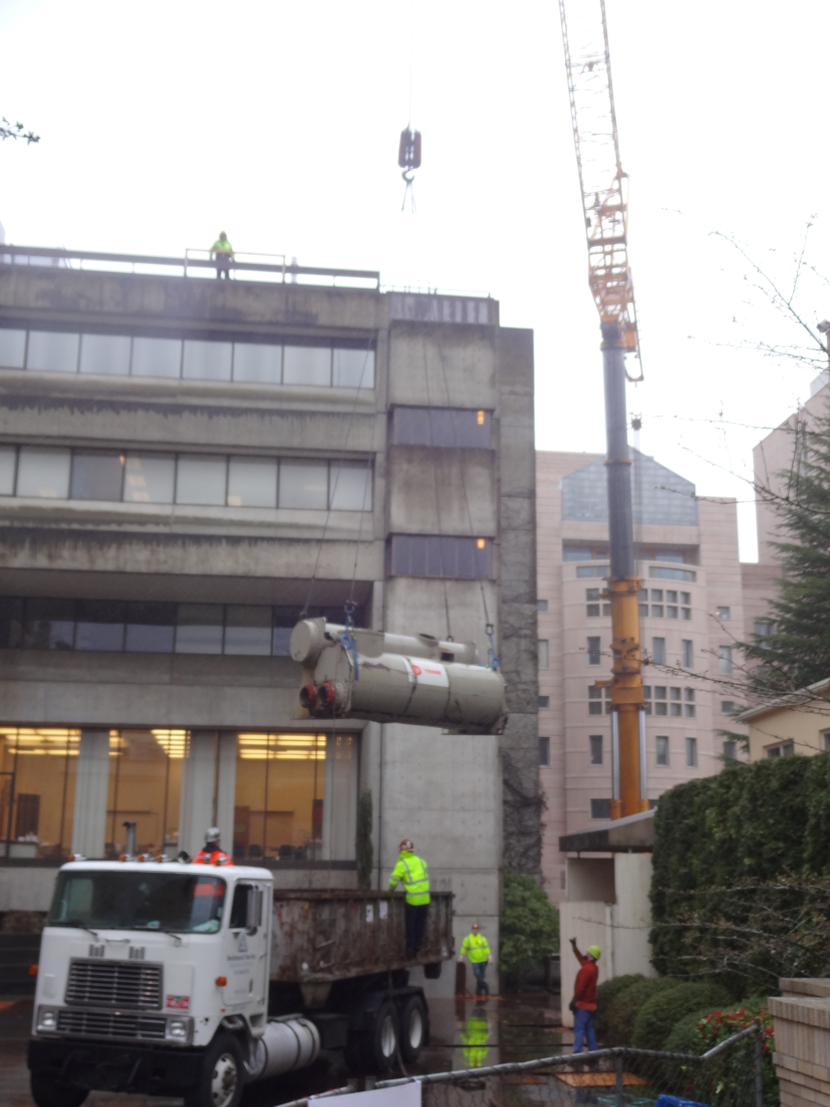

Slide 33
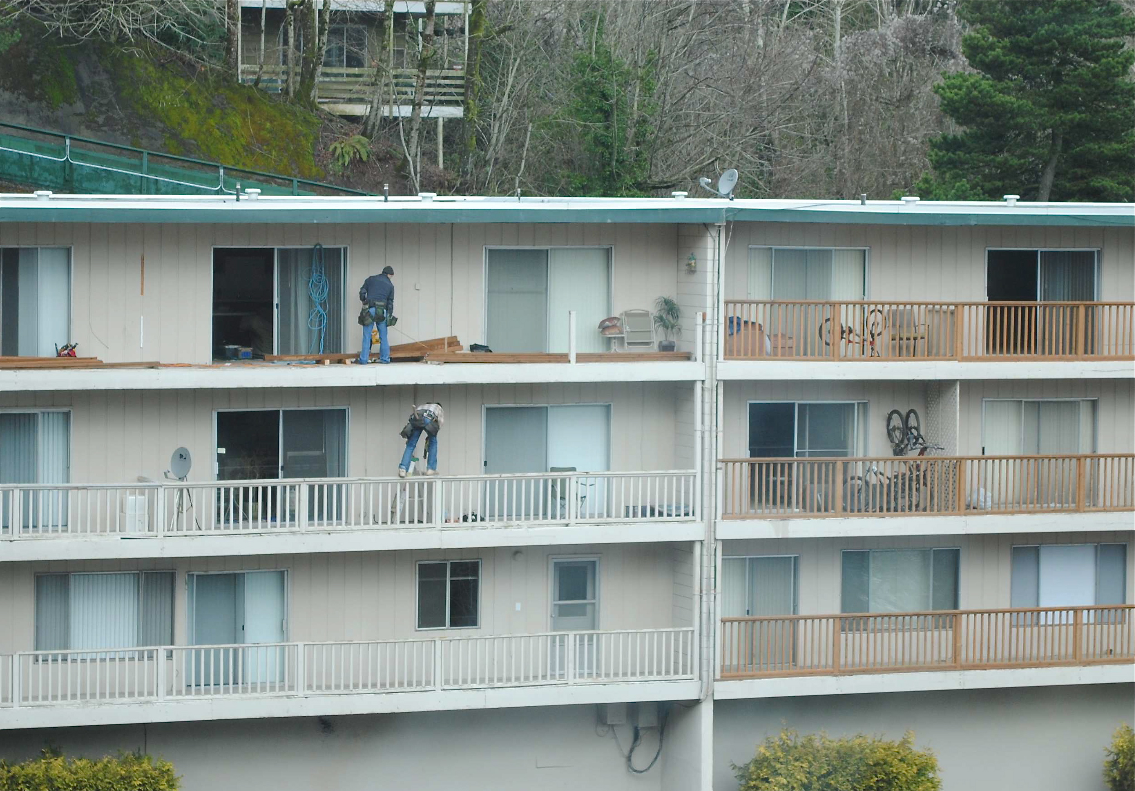

Slide 34
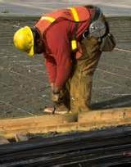
PPT-072-01
35

Slide 35
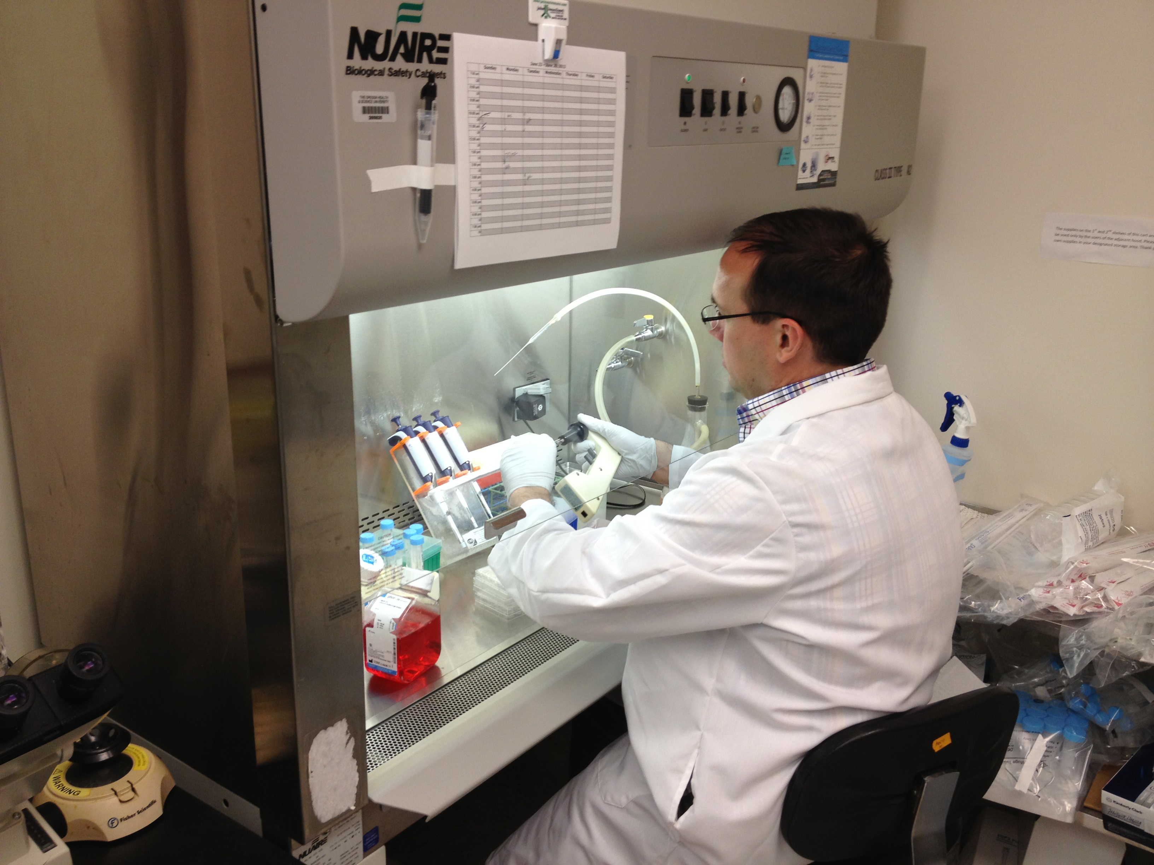

Slide 36


Slide 37
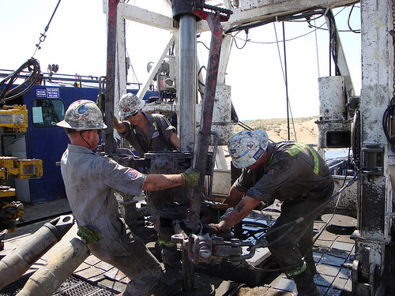

Slide 38
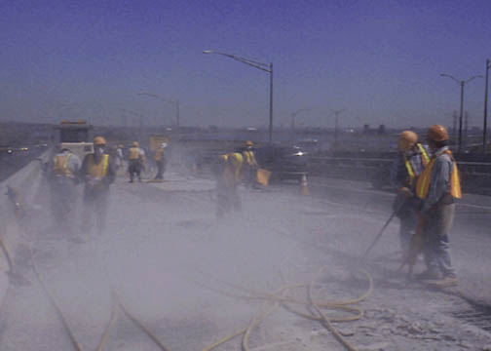

Slide 39
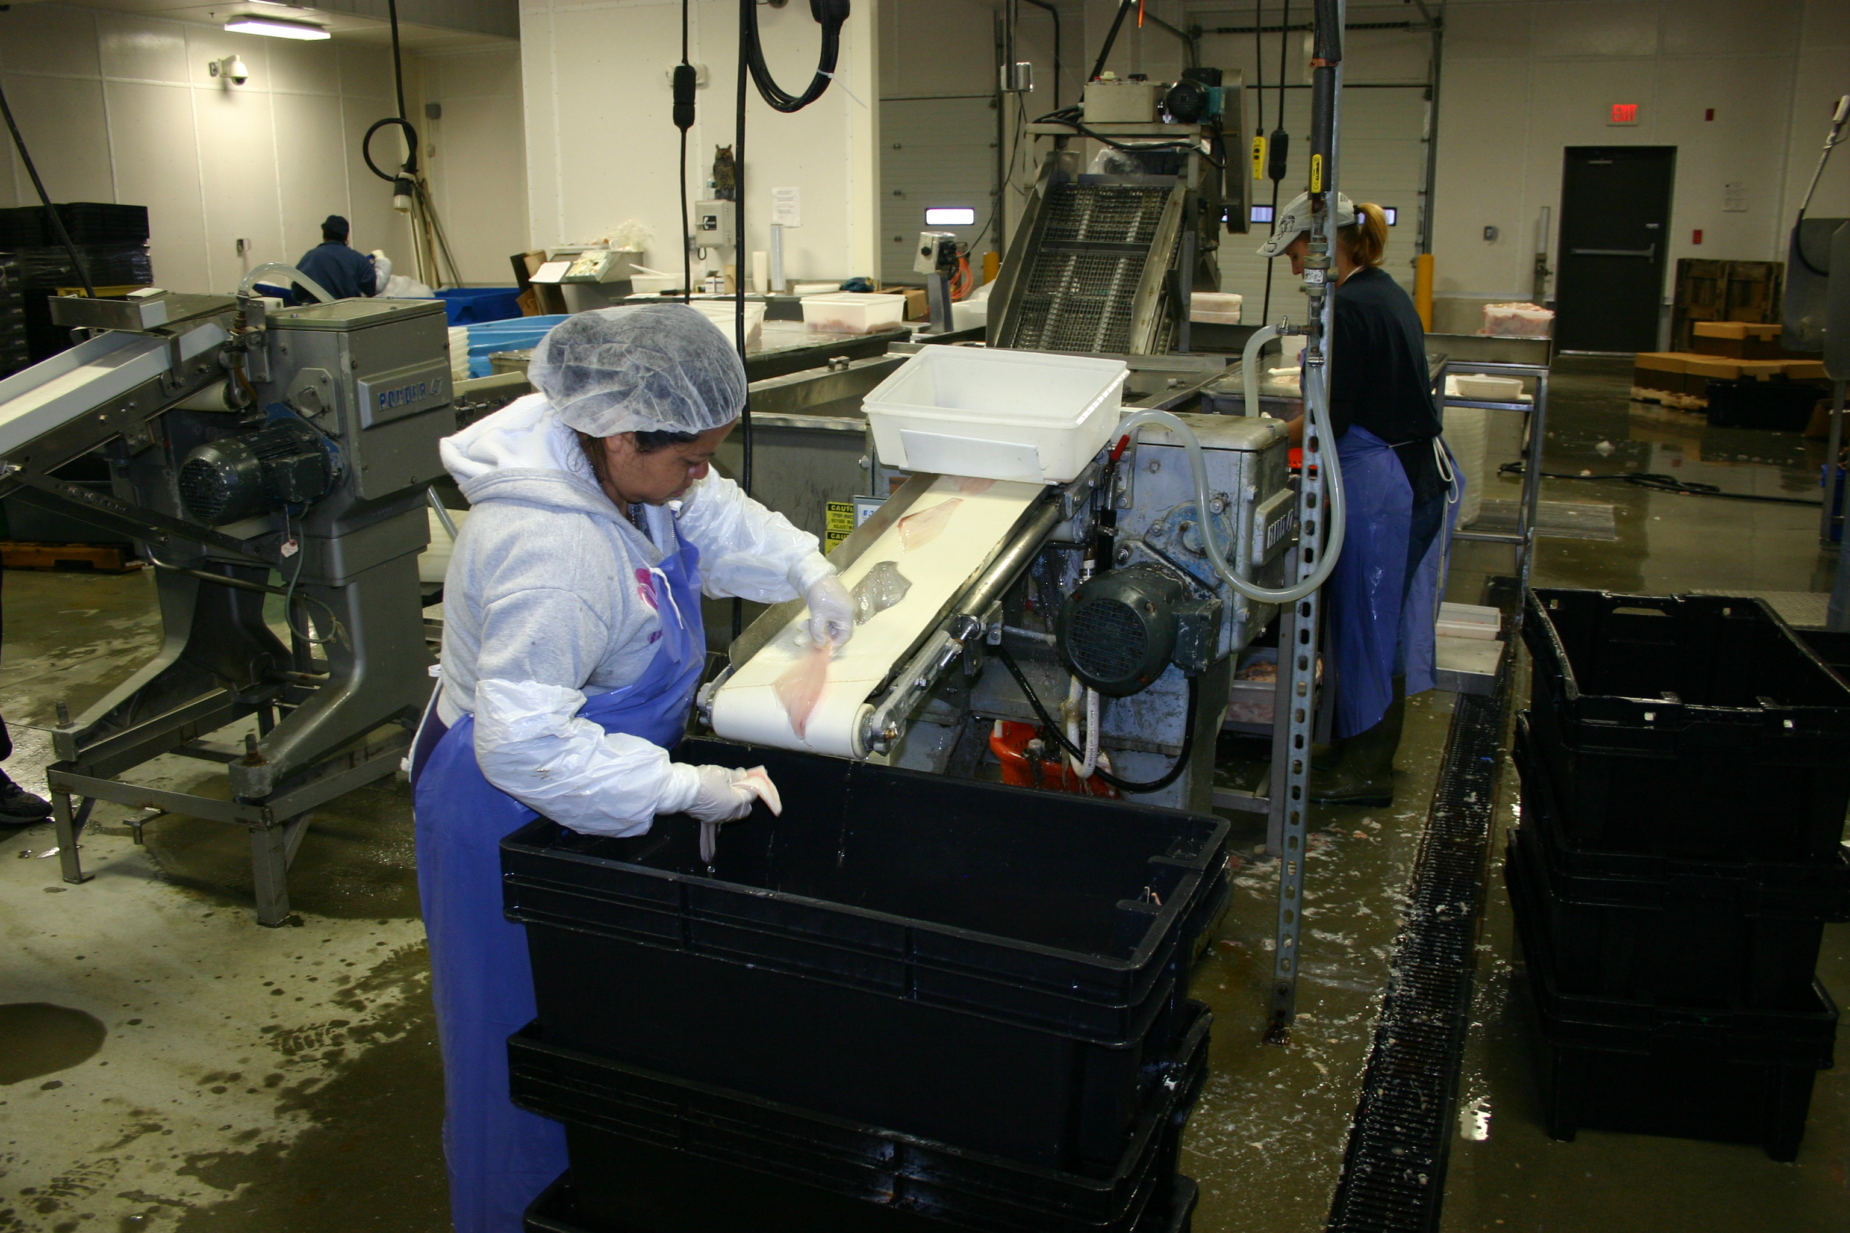

Slide 40
Practicum 1: Hazard Mapping

Slide 41
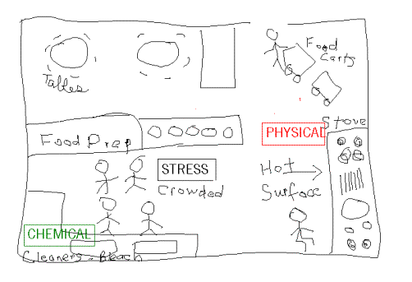
Practicum 1. Hazard Mapping Activity
  Identify Hazards
  Red: physical
  Blue: chemical
  Green: biological
  Purple: other stressors.
Notes:
Divide the class into groups of three or four students. Tell
students that they will work with their group to draw hazard
maps. Each group will choose or be assigned a different type
of workplace and will draw a simple floor plan showing a
typical workplace of that type. They will mark the location
and type of hazards that may be found in that workplace. You
and your students can choose places where young people
often work, such as fast food restaurants, grocery stores,
offices, gas stations, swimming pools, and coffee shops.

Slide 42
Day 1: Key Concepts
Must identify hazards early to protect workers.
Control hazards using “hierarchy of controls.”
Use all information to learn about potential hazards: site history, knowledge about industry and processes, safety information sheets, interviews, site walkthrough, testing
Identifying hazards is not enough: they must be controlled effectively.

