Slide 1
Recap Day 1: Key Concepts
Identify hazards early.
Control hazards using “hierarchy of controls.”
Use all information to learn about potential hazards:
site history
knowledge about industry and processes
safety information sheets
interviews, site walkthrough, testing
Identifying hazards is not enough: they must be controlled effectively.

Slide 2
Day 2 Objectives
Understand: route of exposure, dose/response.
Demonstrate knowledge of basic occupational airborne standards and guidelines, and how they are measured.
Explain the role of personal protective equipment & its limitations.
Understand best practices within Occupational Health Nursing
Perform Practicum 2

Slide 3
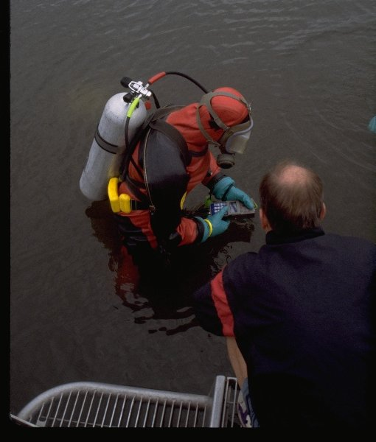
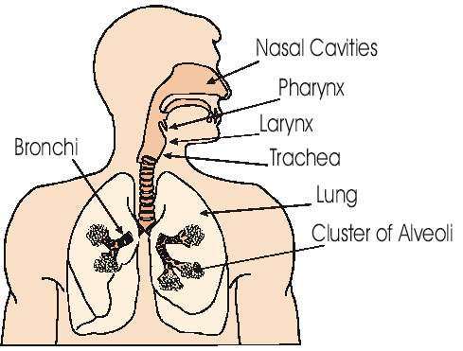
What affects exposure?
Route (skin, oral, inhalation)
Amount (dose)
Duration
To whom (animals, humans, environment)
Sensitivity (e.g., children)

Slide 4
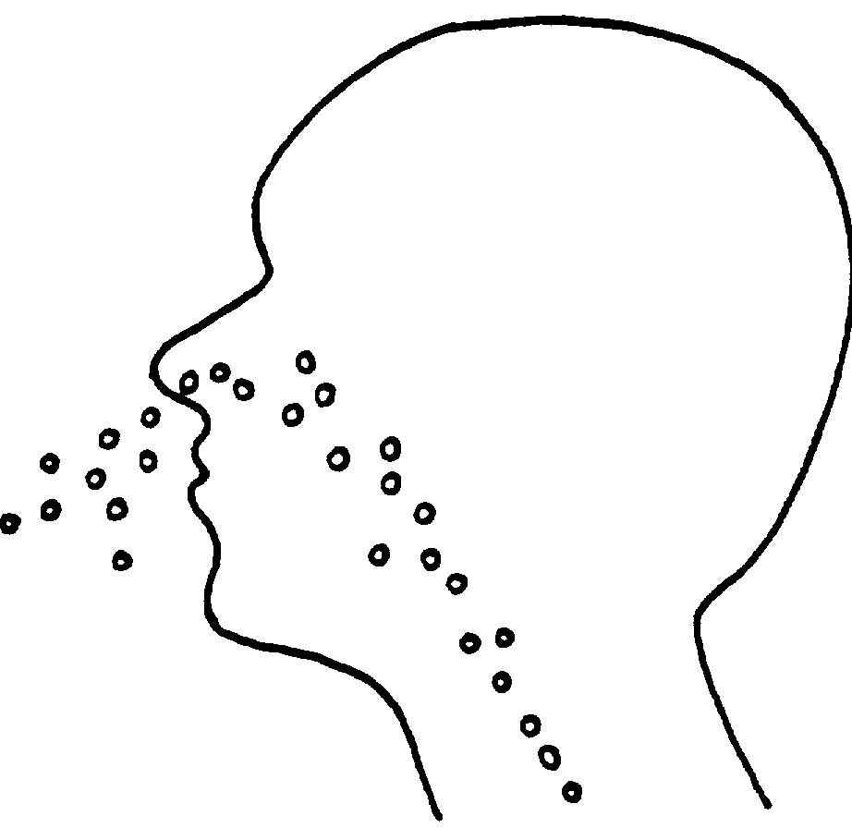
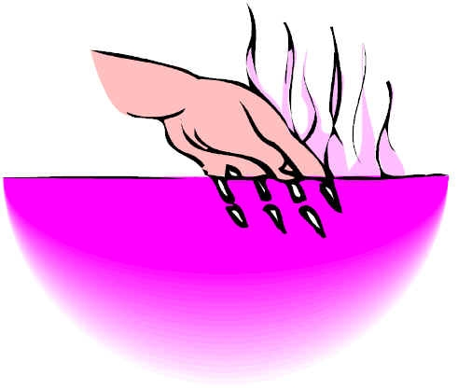
Routes of Exposure
Inhalation
Skin Contact Skin Absorption
Ingestion
Injection

Slide 5
Hazard Categories
Chemical Hazards
Dusts, fumes, Gases, Vapors
Physical Hazards
Noise – Radiation – Vibration – Ergonomics-

Slide 6
Other Hazards
Biological Hazards
Insects, mites
Bacteria
Molds, fungi
Plants
Animals
Ergonomic Stressors
Body posture
Repetitive motion
Fatigue
Shift work
Lifting

Slide 7
Health Effects or Endpoints:
Cancer & genetic changes
Immune function changes
Birth defects & developmental affects
Changes in reproductive function
Nervous system affects
Organ-specific effects
Notes:
May 16, 2016
A Small Dose of Toxicology - Overview
7

Slide 8
The Dose-Response Relationship: How much exposure to a chemical or agent will cause what effect?
Response
ED50
Threshold (NOAEL)
Dose

Slide 9
Signs that a workplace problem may exist:
Employee complains or concerns
Introduction of a new chemical
Unexplained odors present
Accidents or illness reported (test results)
Toxic materials used in process
Processes which may produce exposures
Hazardous chemicals in use

Slide 10
Air Contaminants
Dust: solid mechanically produced particles.
Fume: condensate of volatized solid.
Spray: liquid mechanically produced particle
Mist: liquid condensation particle.
Vapor: gaseous phase of liquid.
Gas: gas at standard temperature and pressure.
Why does it matter?

Slide 11
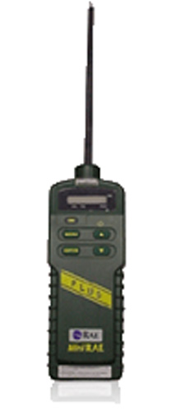
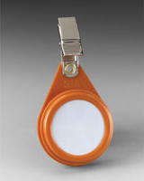
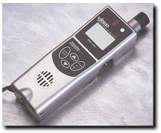
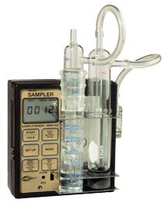
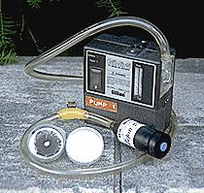
Measuring Workplace Exposures
Biological Samples – blood; urine; hair; exhaled breath

Slide 12
Air Sampling

Slide 13
Potentially Hazardous Processes
Combustion noise, products of combustion
Heating noise, heating effects
Metal melting fumes or dust
Electric discharge ozone, nitrogen oxides
Dry crushing, grinding dust, noise
Mixing, conveying dust, vapors, noise
Coating, painting solvents, pigments
Electroplating acid mist

Slide 14
Potentially Hazardous Processes
Cold or hot forming lubricant, mist, noise
Welding, soldering metal, flux, gases
Warehousing vehicle emissions
Wet mixing mist, dust, noise
Hazardous Waste Ops. dust, gases, noise
Notes:
Discuss odor threshold

Slide 15
Worksite Walkthrough Reminders
Observe the process closely
Interview the people
What do they do? How do they do it?
What do they use? How much?
Evaluate chemical inventory.
What personal protective equipment and workplace controls are in place? Do they appear to be effective?

Slide 16
What to look for. . .
Visible contaminants
Sensory irritation
How are work practices?
Personal protective equipment in use?
Housekeeping & storage
Ventilation systems (general & local exhaust)
Skin contact with chemicals
Sources of additional information?
Exposure assessment?

Slide 17
An Industrial Hygienist’s Toolkit
Occupational Exposure Limits
Type of Sampling
8-hour Time Weighted Averages (TWA)
Short-term Exposure Limits (STEL)
Ceiling Limits (C) Excursion Limits
Personal exposure monitoring
Area or process emissions.
Continuous or integrated.
Grab or instantaneous
“Worst exposure”

Slide 18
Measuring Workplace Exposures
Biological Samples – blood; urine; hair; exhaled breath

Slide 19
Occupational Noise Exposure
It is estimated that 16% of workers experience hearing loss as a result of excessive noise exposure.

Slide 20
Health Effects Related to Noise Exposure
Occupational noise can cause:
Psychological stress and fatigue
Interference with concentration and communication which may result in:
Reduced productivity
Higher risk for injury in the workplace
Permanent hearing loss

Slide 21
Noise Standards in Thailand
Promulgated by the Ministry of Industry and the Ministry of Labour
Permissible exposure level is 90 dBA per 8 hour period
Hearing Conservation program required if noise is greater than 85dBA

Slide 22
Preventing Noise-Induced Hearing Loss: Hierarchy of Control
Engineering controls, i.e., modify or replace equipment, choose low noise tools, isolate noise source
Administrative Controls, i.e., limit exposure time, distance from noisy equipment
Personal Protection: Hearing protection devices

Slide 23
Control
Engineering controls
Substitution; elimination; process change
Isolation; enclosure; distance
Ventilation
Administrative controls
Rotation
Shift adjustment
Housekeeping
Education & training
Personal Protective Equipment
Protective clothing
Respirators

Slide 24
Practicum 2: Review Safety Data Sheet
What is the state(s) or form(s) of the chemical during use?
What are the adverse health effects related to overexposure to this chemical?
What are some of the airborne occupational exposure limits? (Make sure you know how to explain this)
Should someone working with this product wear any type of PPE?
How might we best control or reduce exposure to this product?

Slide 25
Key Industrial Exposures (handout)
Manufacturing
Oil & Gas Extraction
Healthcare
Pharmaceutical

Slide 26
Practicum 3: Exposure Scenario

Slide 27
Day 2: Key Concepts
In order to assess chemical, biological and health exposures, they must be identified and evaluated.
Safety data sheets, and other chemical information are useful to better understand hazards related to chemicals, and how to reduce exposures.
Reducing exposure through controls (including elimination and substitution) are critical to improving workplace health.

