Slide 1
Documentation

Slide 2
Why is documentation important?
Quality care
Care team communication
Hazard identification
Reimbursement
Allows measuring for process improvement

Slide 3
Process Improvement tools
Process Mapping
Waste Walk
6 S

Slide 4
Employer site documentation
Consider checklist for quality and safety checks
Equipment daily checks
First aid log: log all visit types
Problem solving documentation: SOAP
Audit results and recommendations

Slide 5
Documentation supports reimbursement
Complete documentation to ensure reimbursement
Codes, orders, tests, time spent
Learn reimbursement rules and set policies and processes

Slide 6
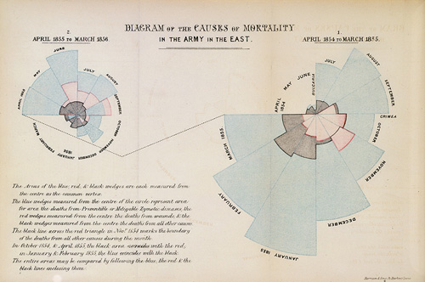
Thank you!
What questions do you have?

