Slide 1
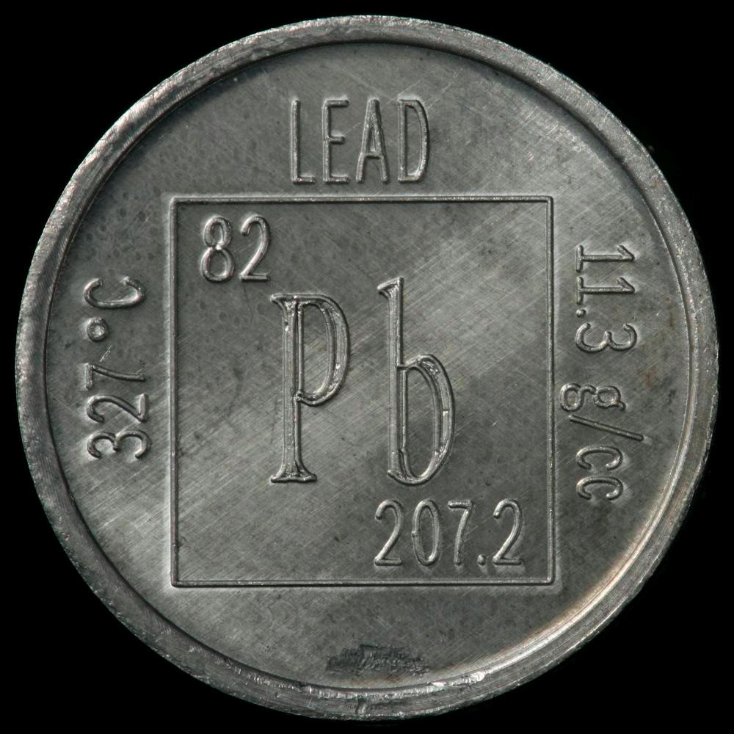
Robert Hendrickson, MD

Slide 2
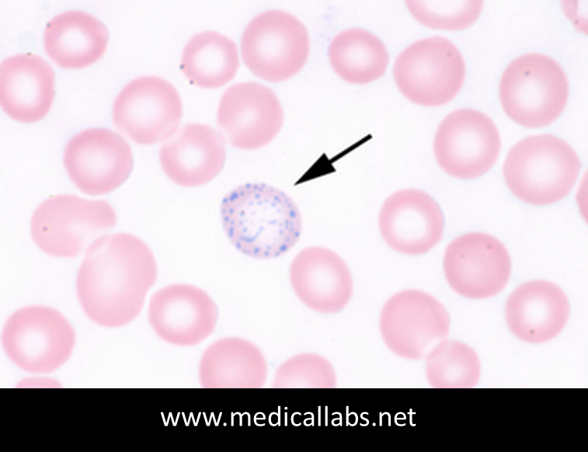
Case # 1
42 yo man
Construction / renovation of houses
Symptoms: Headaches, fatigue, constipation with occasional bouts of crampy abdominal pain. Wife describes him as “irritable”.
Exam: Hypertension (170/90mmHg)
Labs: Hemoglobin 7.5 g/dL

Slide 3
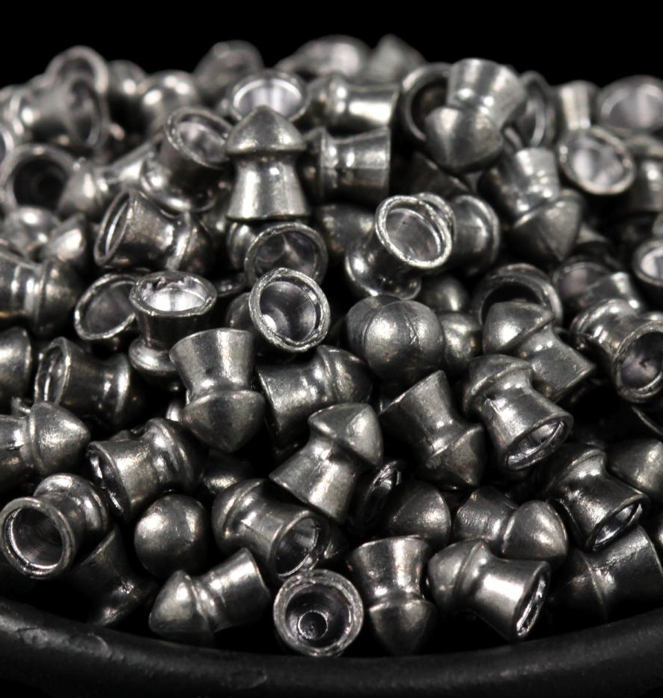
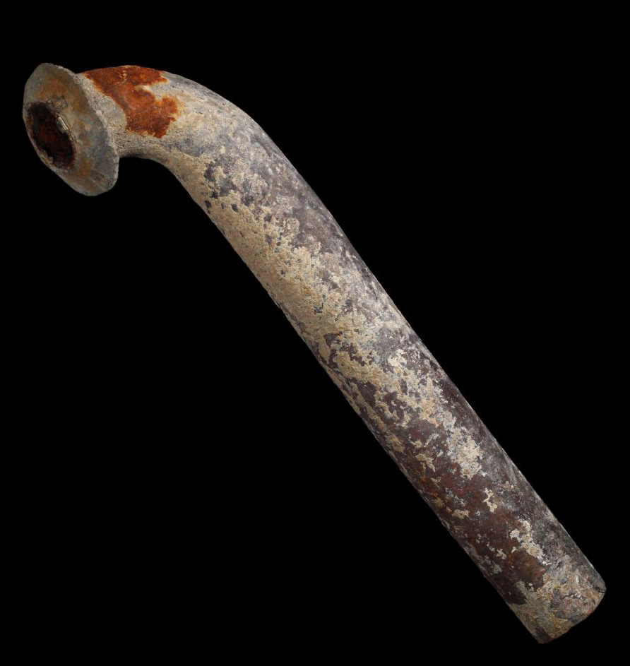
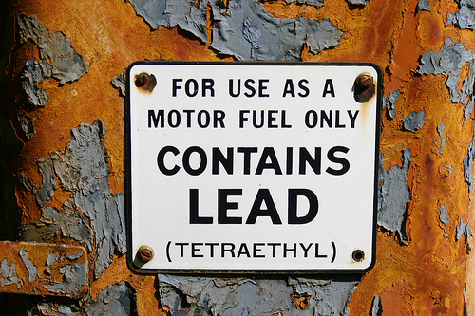
Lead
Naturally occurring element
Types:
  Inorganic lead
    Metallic
    Lead oxides and salts
  Organic lead
    E.g. in gasoline as tetraethyl lead

Slide 4
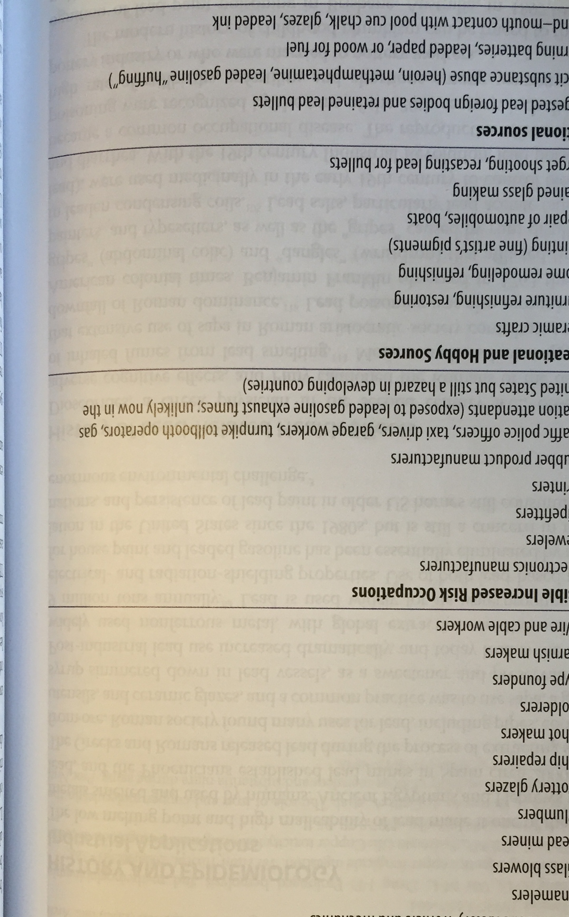
Lead
How do workers get exposed?
  Paint
  Piping/welding
  Battery manufacture
  Colors – glassblowers, pottery, stained glass
  Gasoline
  Smelting/mining

Slide 5
Lead
How do workers get exposed?
  Paint
  Piping/welding
  Battery manufacture
  Colors – glassblowers, pottery, stained glass
  Gasoline
  Smelting/mining
Non-occupational exposures:
  Pottery glazes
  Bullets – target shooting, bullet recycling
  Fishing sinkers
  Home remodeling (paint)

Slide 6


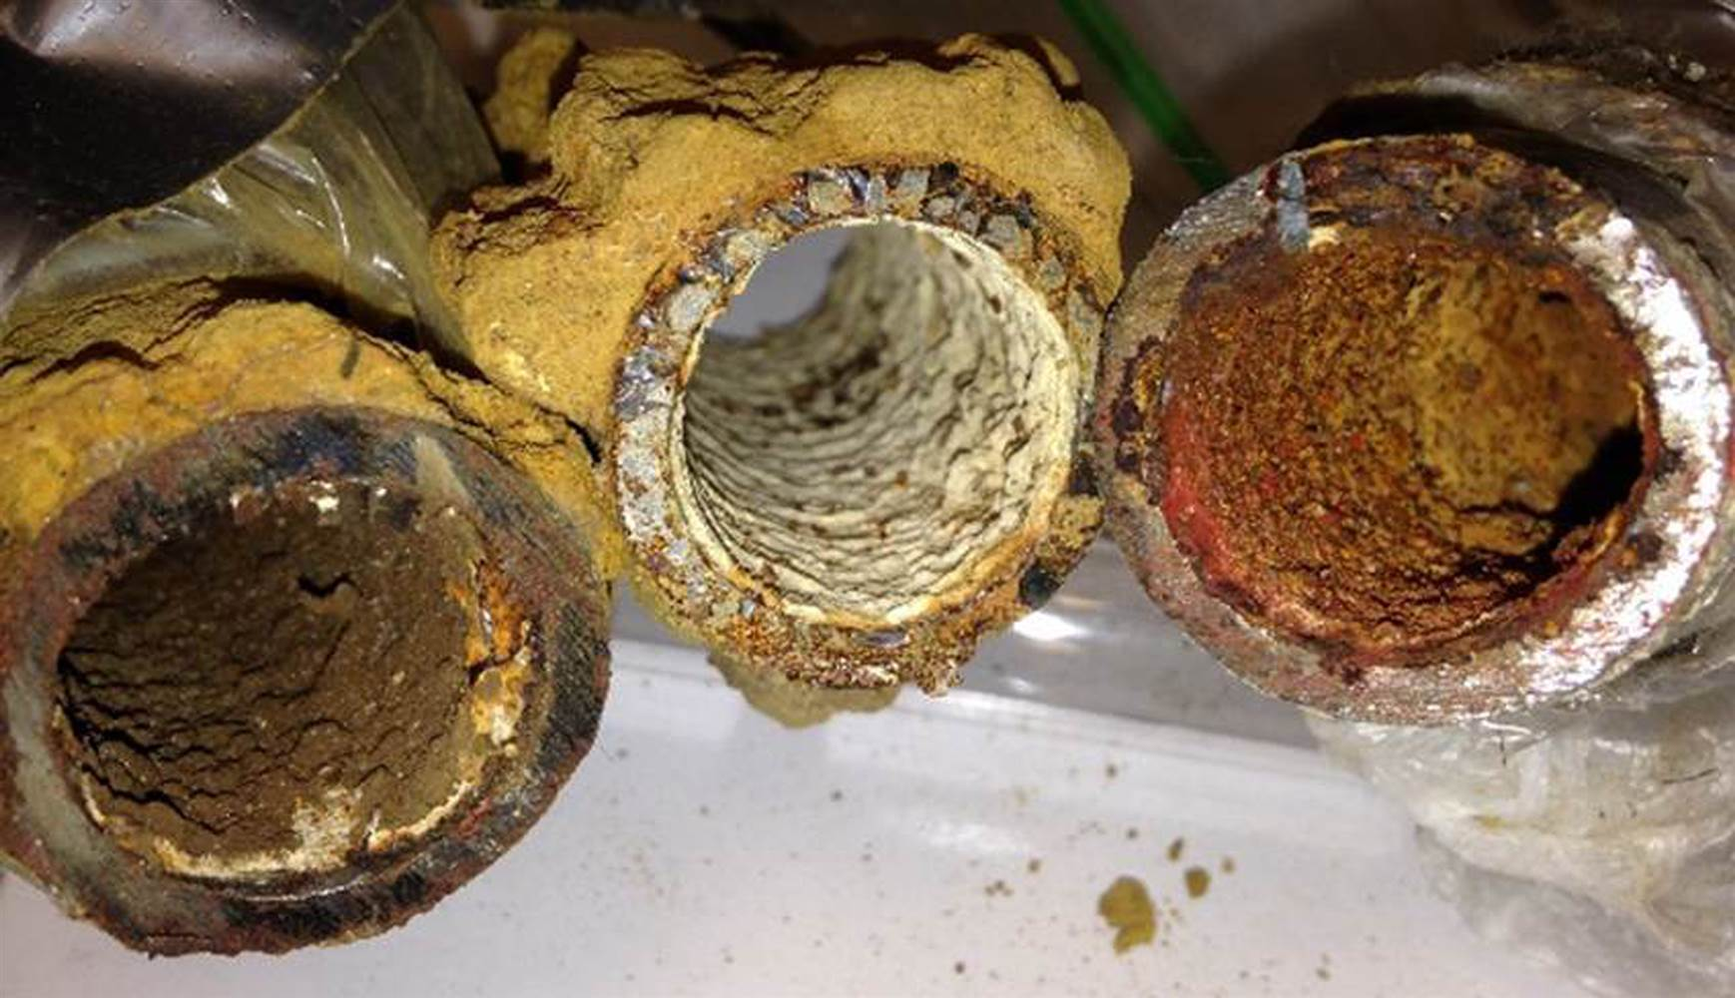
Lead
Environmental sources:
  House paint & dust
  Soil – near highways
  Water – pipes/fixtures & solder
  Air – gasoline & energy production

Slide 7

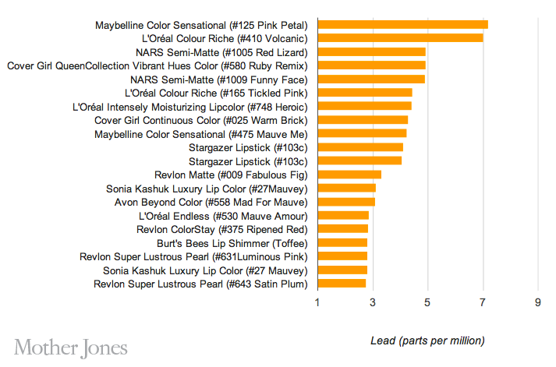

Lead
Other sources:
  Alternative medicines
  Toys & jewelry
  Cosmetics
Notes:
Daw Tay – digestive aid used in Thailand; 970ppm lead and 7100ppm arsenic

Slide 8
Lead – clinical effects
Mild: (>20mcg/dL)
  Fatigue, irritability
  Hypertension
Moderate: (>70mcg/dL)
  Headache, memory loss
  Peripheral neuropathy
  Abdominal pain, constipation, “colic”
  Gout
  Anemia (basophilic stipling)
Severe: (> 100 mcg/dL)
  Nephropathy
  Encephalopathy (obtundation, seizures, papilledema, increased ICP)
  Foot/wrist drop (peripheral neuropathy)

Slide 9
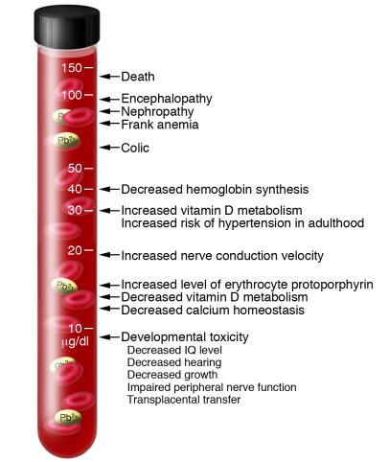
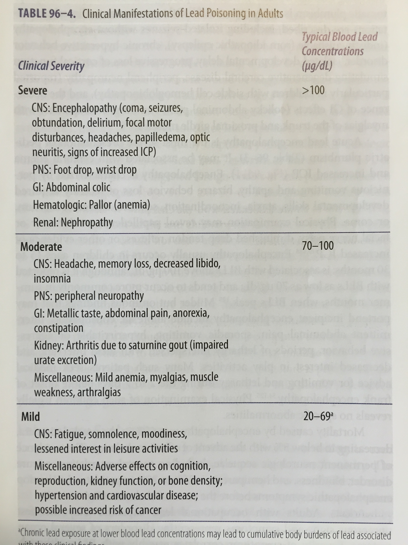
Lead – clinical effects

Slide 10
Lead – biological monitoring
OSHA – if workers are exposed to airborne lead over the “action level”, then those employees must be monitored.
  “Action level” (AL) = 30mcg/m³ TWA-8h
  PEL = 50mcg/m³ TWA-8h
  If >AL for 30 days in one year, then medical monitoring:
Environ Health Perspect 2007; 115; 463-471

Slide 11
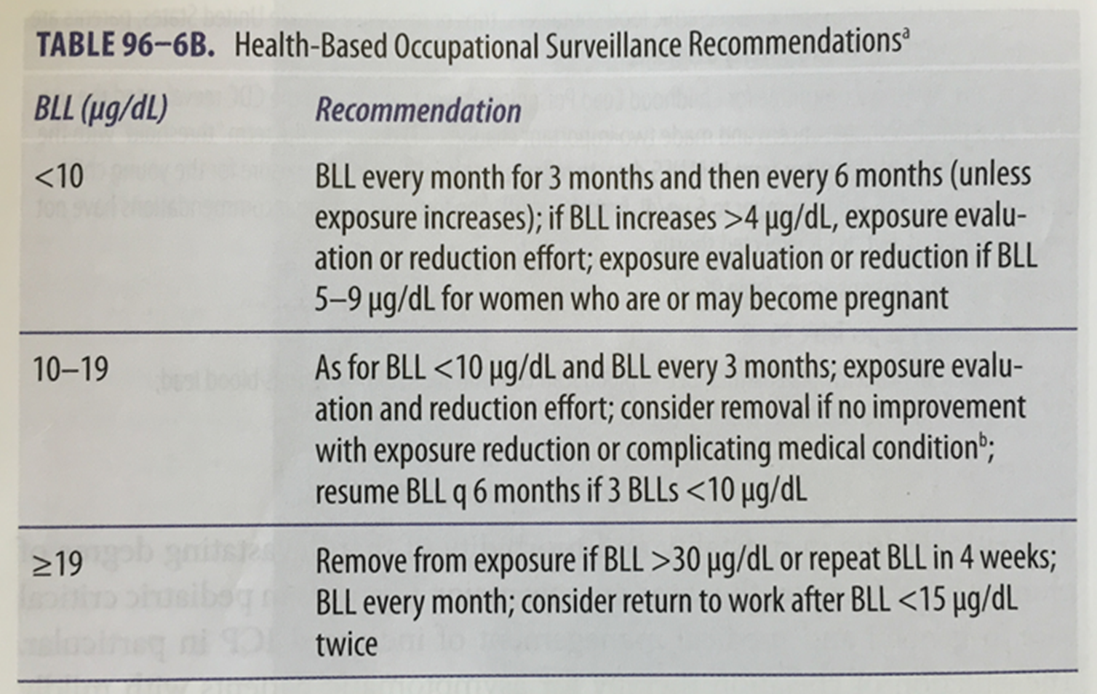
Lead – biological monitoring
Environ Health Perspect 2007; 115; 463-471
Environ Health Perspect 2007; 115; 463-471

Slide 12
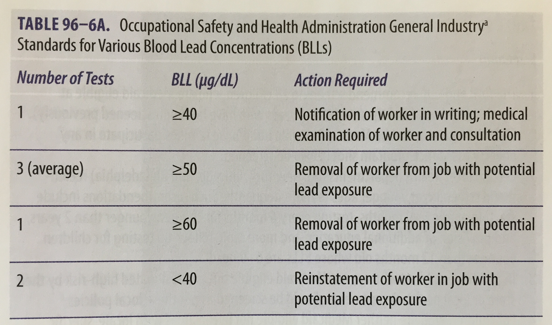
Lead – medical removal
Environ Health Perspect 2007; 115; 463-471

Slide 13
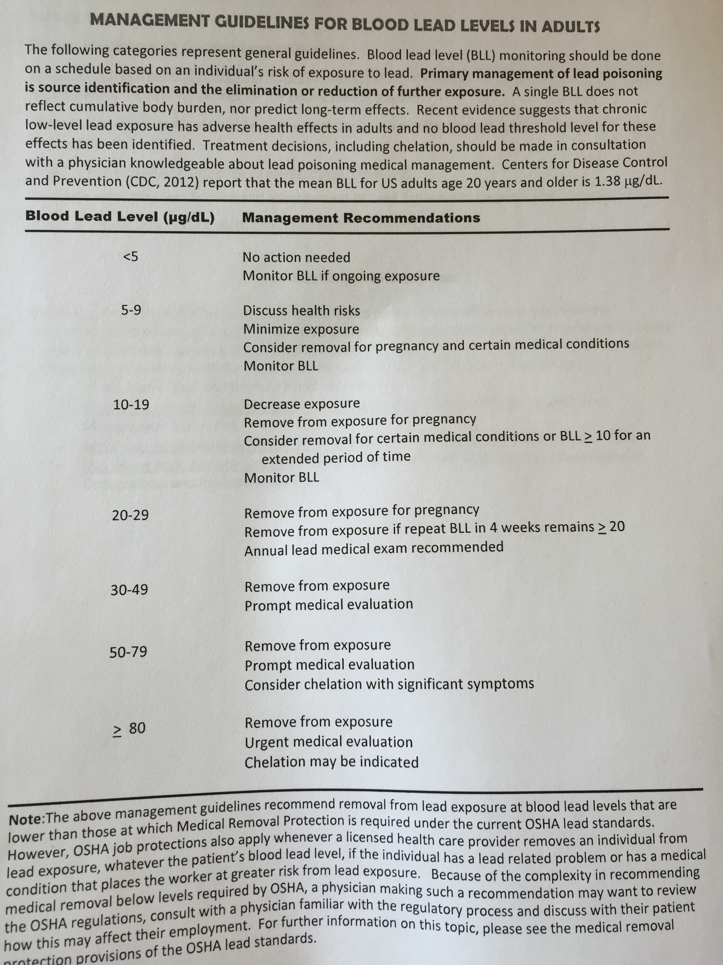
Management Guidelines, Council for State and Territorial Epidemiologist (CSTE), accessed www.osha.gov/SLTC/lead/
Environ Health Perspect 2007; 115; 463-471

Slide 14
Lead – evaluation and treatment
Removal from exposure
  Workplace evaluation
    ?decrease dust/fume production
    ?increase local/general ventilation
    Personal protective equipment
      Respiratory protection
    Hygiene
      No smoking, eating, drinking in lead-prominent work areas
      Work clothes should be changed after every shift and NOT lockered together with street clothes
    Removal from workplace?
  Home evaluation

Slide 15
Lead – evaluation and treatment
Removal from exposure
Optimize nutrition
  Iron (decreases lead GI absorption)
  Calcium (decreases lead GI absorption)
  Vitamin C (may increase lead excretion)

Slide 16
Lead – evaluation and treatment
Removal from exposure
Optimize nutrition
Chelation?

Slide 17
Lead – evaluation and treatment
Condition, BLL (mcg/dL) | Chelator and dose
Encephalopathy or BLL > 100 mcg/dL | BAL IM 75mg/m² q4h x 5d & CaNaEDTA 1000-1500 mg/m²/d (max of 3g/d) infusion
Mild symptoms or BLL > 70 mcg/dL | DMSA 10mg/kg TID x 5d, then 10mg/kg BID x 14d
Asymptomatic and BLL < 70 mcg/dL | No chelation

Slide 18
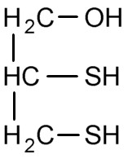
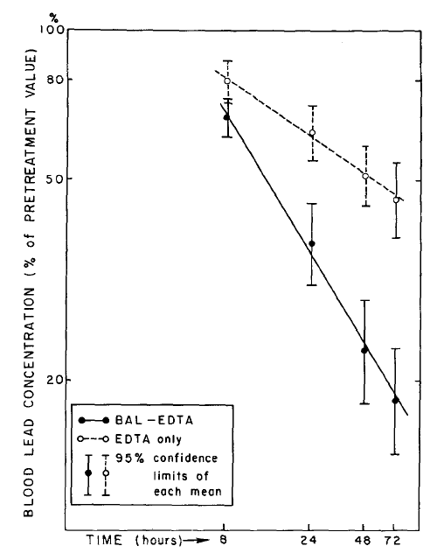
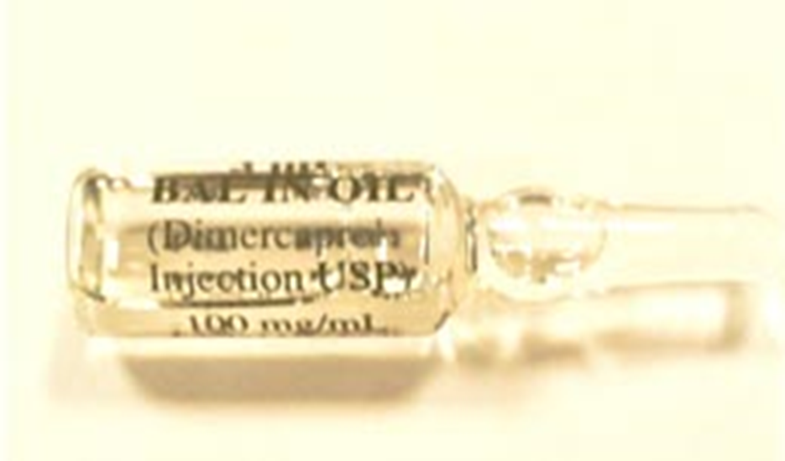
Chelators
BAL (dimercaprol, British anti-Lewisite)
  Peanut oil
  Deep IM
  Adverse effects (14% at 4mg/kg):
    Tachycardia/hypertension
    Hyperthermia (children; 30%)
    HA, lacrimation, salivation, rhinorrhea, myalgias, anxiety, resolves in 1 hour
J Pediatr 1968; 73(1): 1-38

Slide 19
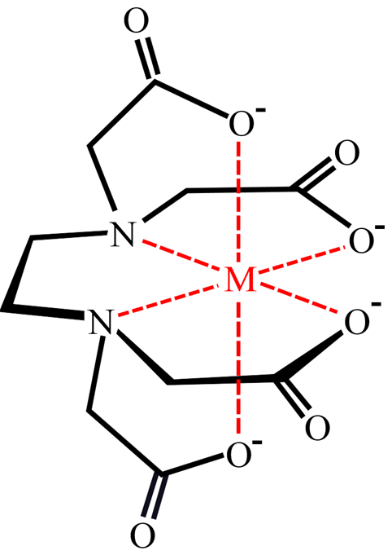
Chelators
CaNaEDTA
  4h after BAL to avoid increasing CNS [lead]
  Adverse effects:
    Renal insufficiency (13%)
    Oliguric renal failure (3%)
    Malaise, chills, myalgias, HA
    Zinc deficiency – cheilitis, magenta tongue, papular rash
    AST/ALT increase

Slide 20
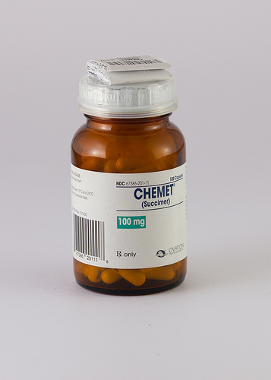
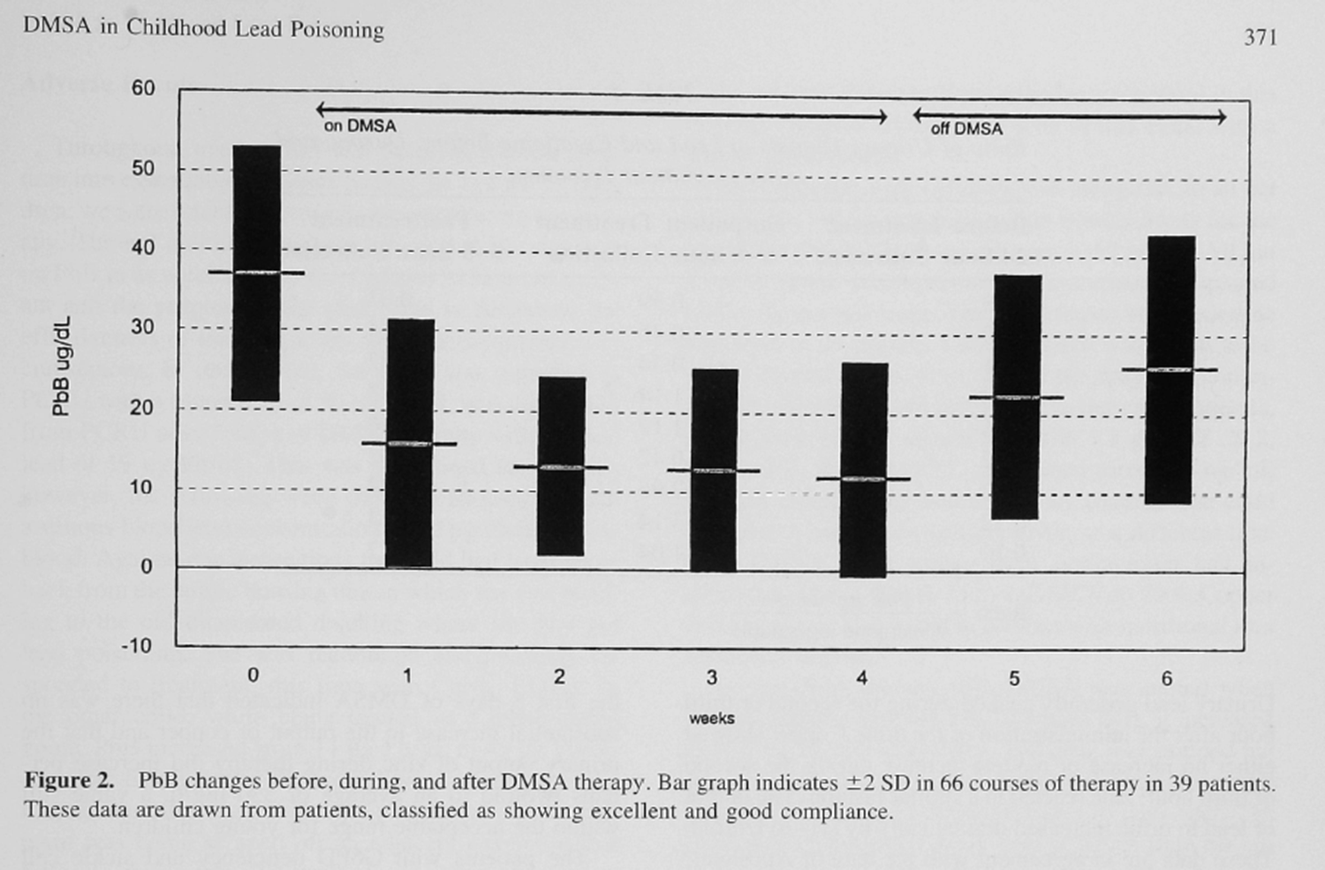
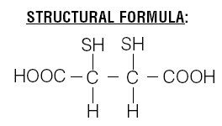
Chelators
DMSA
  Oral
  Adverse effects mild:
    GI upset, sulfur smell

Slide 21
Chelators
Chelation – does it work?
  Reduces symptoms
  Rapidly decreases lead concentration

Slide 22
TLC trial: N Engl J Med 2001; 344: 1421-6

Slide 23
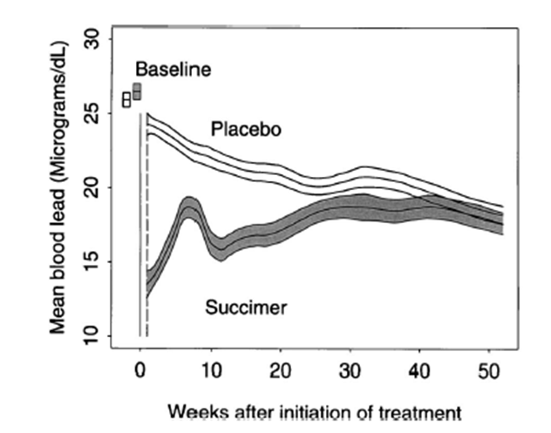

Slide 24
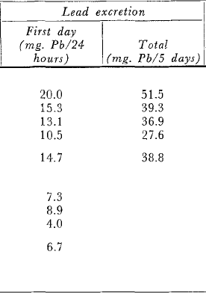
J Pediatr 1968; 73:1-38
w/ EDTA

Slide 25
Case # 1
42 yo man
Construction / renovation of houses
Symptoms: Headaches, fatigue, constipation with occasional bouts of crampy abdominal pain. Wife describes him as “irritable”.
Exam: Hypertension (170/90mmHg)
Labs: Hemoglobin 7.5 g/dL
BLC: 78 mcg/dL

Slide 26
Case # 1
BLC 78 mcg/dL
Treatment:
  Removal of exposure
  DMSA – for symptom control
  Iron, calcium, and vit C supplementation
  Monthly BLCs until his BLC decreased
  Recommended change in job
    Out of work until BLC < 40 mcg/dL

Slide 27


Questions and discussion…

Slide 28
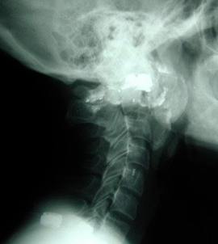
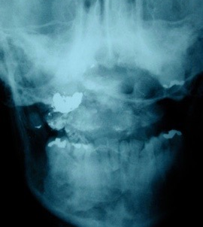
Lead

Slide 29

Lead

