Slide 1
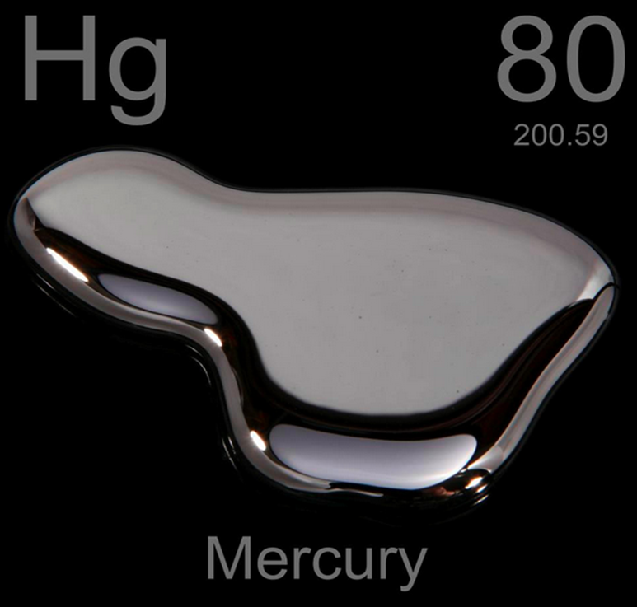

Slide 2
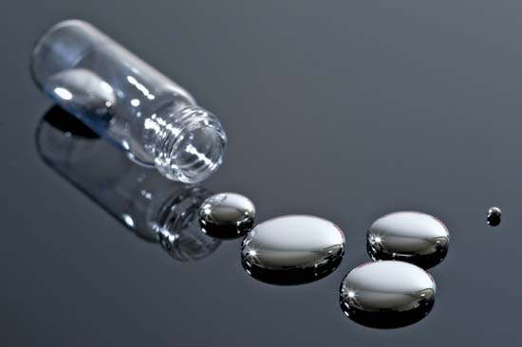
Mercury
Elemental

Slide 3
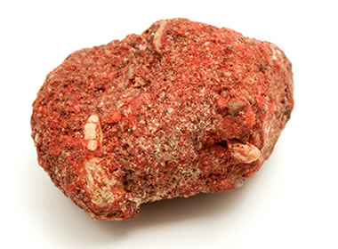
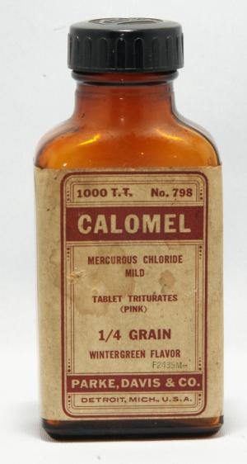
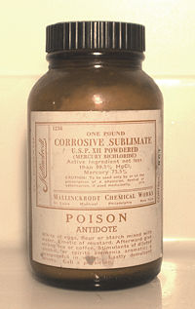
Mercury
Elemental
Inorganic
  Mercuric sulfide (cinnabar)
  Mercurous chloride (calomel) - teething
  Mercuric chloride (corrosive sublimate)
    Tx of syphilis
    PVC production
    Photographic intensifier
Notes:
Mercuric chloride is a catalyst that converts acetylene to vinyl chloride.

Slide 4
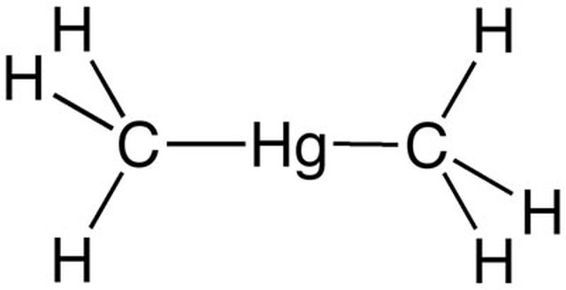
Mercury
Elemental
Inorganic salts
  Mercuric sulfide (cinnabar)
  Mercurous chloride (calomel)
  Mercuric chloride (corrosive sublimate)
Organic
  Methylmercury, Dimethylmercury
  Phenyl mercuric acetate (paint and as antifungal in seeds)

Slide 5
Mercury
Non-occupational uses:
  Calomel for teething
  Ayurvedic medicines
  Dental amalgam
  Paint - banned in indoor paint - phenyl mercuric acetate
    1990 [US]
    2017[Thailand]

Slide 6
Mercury
Occupational uses:
  Elemental –
    Dental amalgam
    Electroplaters
    Jewelers
    Paper pulp workers
    Photographers
    Thermometer/barometer manufacture
  Inorganic –
    Dye industry
    Explosives/fireworks
    Lab workers
    Taxidermists/tannery
  Organic
    Fungicide/pesticide
    Histology techs
    Wood preservatives
Notes:
Mercuric sulfide = red tatoo paint

Slide 7

Mercury toxicity
Inorganic mercury
  Oral & Dermal
    Caustic (GI)
    ATN (renal)
    Neurologic effects:
      Intention tremor
      Erethism (blushing, shyness, emotional lability, irritability)
      Sensorimotor neuropathy
      Ataxia
      Gingivostomatitis, sensation of loose teeth
      Hypersalivation (ptyalism)
      Tunnel vision (constriction of visual fields)
Notes:
Lethal dose = 30-50mg/kg

Slide 8

Mercury toxicity
Elemental mercury
  Inhalational
  Acute = Lung injury
  Chronic = converted in the CNS to inorganic mercury -> CNS effects

Slide 9
Mercury toxicity
Organic mercury:
  Oral
  Long-chain alkyl mercury
    Cleaved to inorganic mercury
  Short-chain aryl mercury (e.g. methylmercury)
    Distributes to CNS and slowly converted to inorganic mercury
  Toxicity = delayed onset neurologic toxicity

Slide 10
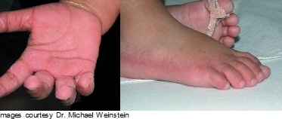
Mercury toxicity
“Pink disease”
  First described in children treated with calomel
  Signs:
    Erythematous, edematous, hyperkeratotic induration of hands, feet, and face
    Sweating, tachycardia, irritability, tremor
  Idiosynchratic hypersensitivity reaction

Slide 11
Mercury - testing
Elemental or inorganic mercury
  24 hour urine mercury in metal-free container
Organic mercury
  Whole blood mercury
    Organic mercury accumulates in RBCs
    Eliminated via feces, so urine is not appropriate

Slide 12
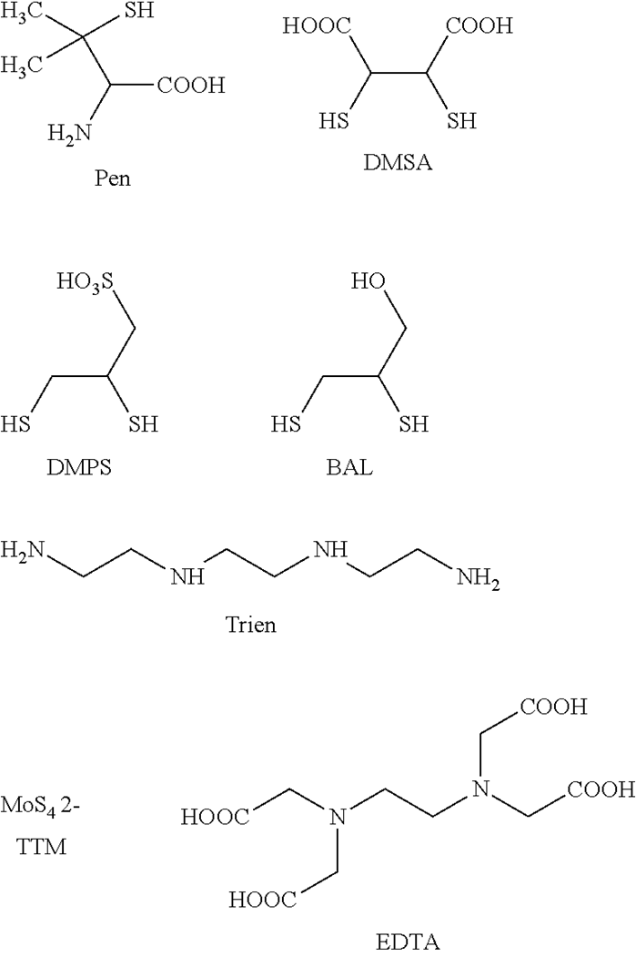
Mercury - treatment
Indications:
  History of mercury exposure & typical symptoms
    Urine/blood confirmatory
Notes:
Organic mercury has few GI symptoms, so choice is not difficult.
D-penicillamine – aplastic anemia, myasthenia gravis,

Slide 13
Mercury - testing
 | Blood | Urine | Comments
NHANES (US national mean) | 0.6mcg/L | 0.5mcg/L
US EPA |  | > 35mcg/L | Initiate medical surveillance (US EPA)
US EPA |  | > 100mcg/L | Consider temporary removal (US EPA)
 | >35mcg/L | >150mcg/L | “May be associated with nonspecific symptoms” Mandatory removal (US EPA)
 | >100mcg/L | >200mcg/L | Generally seen in patients with toxicity
Notes:
“May be associated with nonspecific symptoms” – Goldfrank; Casarett and Doull’s

Slide 14
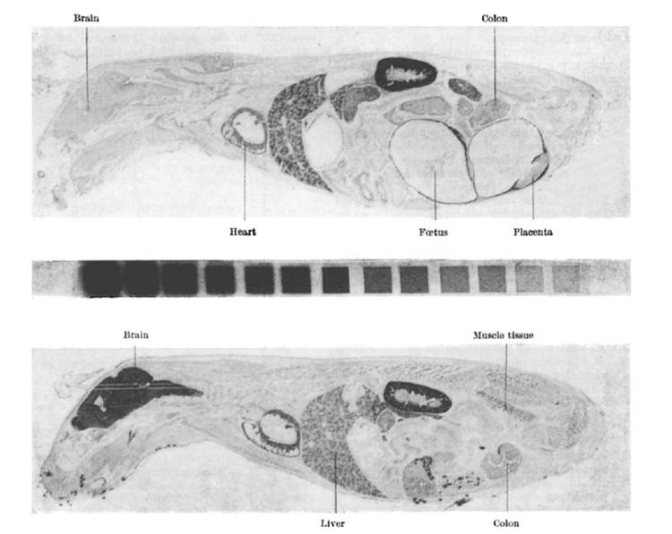
Mercury - treatment
Chelation:
  Elemental / inorganic –
    BAL / DMSA
    D-penicillamine or DMPS
  Organic – DMSA
Notes:
Organic mercury has few GI symptoms, so choice is not difficult.
D-penicillamine – aplastic anemia, myasthenia gravis,
Phenyl mercuric acetate, killed 8 days later.
(organic mercury = increased brain uptake; inorganic mercury = no increased uptake)
Mercury 203, 0.5mg mercury/kg body weight.
BAL 0.4mg/kg

Slide 15
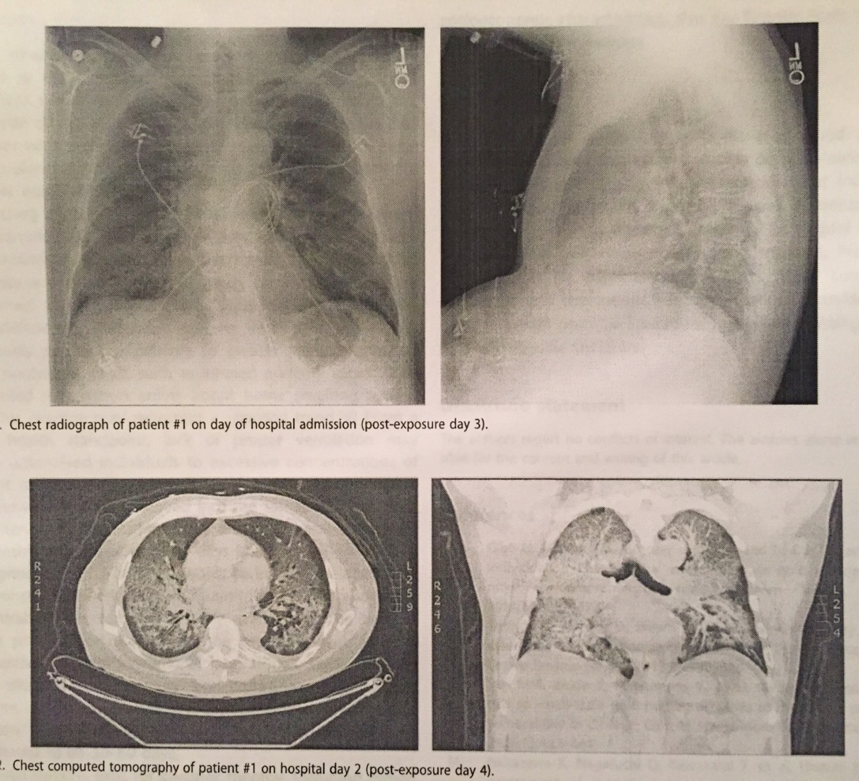
Cases
61yo man “reclaiming gold” from computer chips, jewelry, cell phones.
Heated elemental mercury (thermometers) with butane torch
Blood > 200 mcg/L
Intubated
BAL, then DMSA

Slide 16
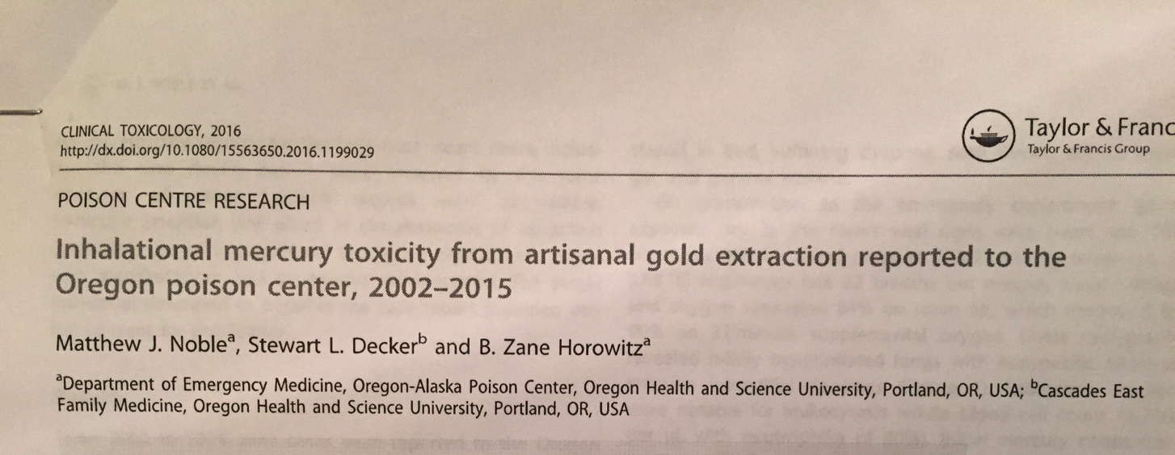
Cases
Notes:
Organic mercury has few GI symptoms, so choice is not difficult.
D-peni
Phenyl mercuric acetate, killed 8 days later.
(organic mercury = increased brain uptake; inorganic mercury = no increased uptake)
Mercury 203, 0.5mg mercury/kg body weight.
BAL 0.4mg/kg
cillamine – aplastic anemia, myasthenia gravis,

Slide 17

Cases
48yo chemist (Dartmouth)
Dimethylmercury
  3 mo. Abd pain/ Weight loss
  5 mo. Ataxia/slurred speech/ tinnitus/ “tunnel vision”
    Blood mercury 4000mcg/L
    Urine 234 mcg/L
    DMSA / exchange transfusion
    22 days – unresponsive
    Care withdrawn ~1 year after exposure
Notes:
Organic mercury has few GI symptoms, so choice is not difficult.
D-peni
Phenyl mercuric acetate, killed 8 days later.
(organic mercury = increased brain uptake; inorganic mercury = no increased uptake)
Mercury 203, 0.5mg mercury/kg body weight.
BAL 0.4mg/kg
cillamine – aplastic anemia, myasthenia gravis,

Slide 18


Questions and discussion…

